Slide 1

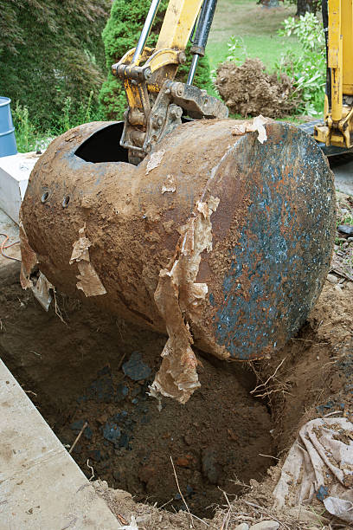
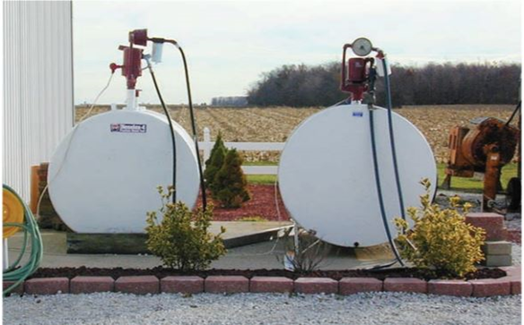

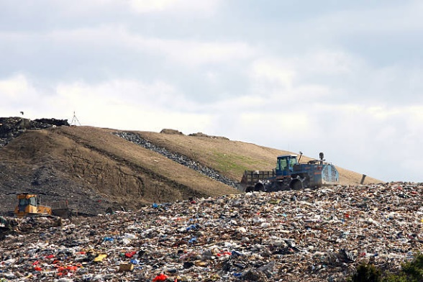
Training for Guaranteed Lenders: Environmental Responsibilities and Due Diligence
Notes:
Matt Henderson -

Slide 2

Training Overview
Teams Live Event
Length: Approximately 1 – 1.5 hours
Participants muted
Type Questions under Q & A (top right of Screen)
We will respond both during presentation and after
The meeting will be recorded, and slides will be made available
Presenters Matt Henderson, Calvin Greer, Jason McMillin

Slide 3
Agenda
The NEPA Process
  Roles and Responsibilities NEPA
  Common NEPA Questions
The Due Diligence Process
  Recognized Environmental Condition (Scope)
  Roles and Responsibilities Due Diligence
  Common Due Diligence Questions

Slide 4

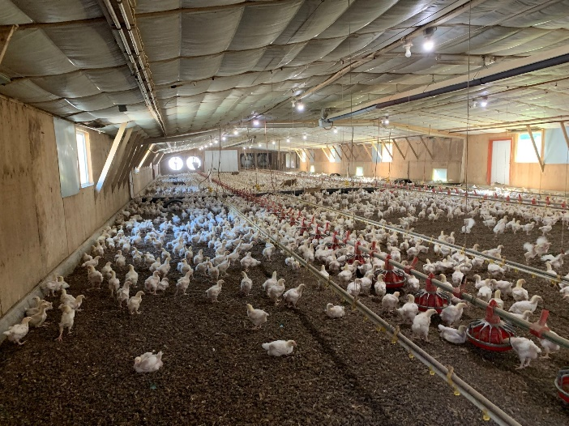
National Environmental Policy Act (NEPA)
The NEPA Process
Roles and Responsibilities
Common NEPA Questions
Notes:
4

Slide 5
National Environmental Policy Act (NEPA)
What is NEPA?
The National Environmental Policy Act (NEPA) was signed into law on January 1, 1970. NEPA requires federal agencies to assess the environmental effects of their proposed actions prior to making decisions. The range of actions covered by NEPA is broad. Using the NEPA process, agencies evaluate the environmental and related social and economic effects of their proposed actions. Agencies also provide opportunities for public review and comment on those evaluations.

Slide 6

The NEPA Process
NEPA
National Environmental Policy Act
CatExs
Executive Orders 11988
11990
13112
13690
13807
12898
Noise Control Act
Soils
CAA
Section 106
Endangered Species Act
CWA
CZMA
Socioeconomic Impacts and Environmental Justice
Many Others
Safe Drinking Water Act
CBRA
Wild & Scenic Rivers Act
Wilderness Act
Floodplains
National Natural Landmarks
Historic Sites Act of 1935
Environmental Assessments
Environmental Impact Statement

Slide 7
The NEPA Process
EIS
Environmental Assessment
Supported CatEx (S & SG-CatEx)
(SG-CatEx = Full completion of FSA-850)
(S-CatEx = Limited completion of FSA-850)
Listed CatEx (L-CatEx)
(L-CatEx = Limited completion of FSA-850)
Environmental Assessments -
  New Ground Disturbance Extraordinary Circumstances
Supported With Ground Disturbance - New Ground Disturbance
Supported - No or Previously Disturbed Ground
Listed - No Ground Disturbance or (not below previous disturbance)

Slide 8
Roles and Responsibilities NEPA
Guaranteed Lenders Assist in the environmental review process by providing information requested by FSA (2-FLP Paragraph 208)
  Prepare the producer for early consultation
  Participate in the Kickoff meeting
  Facilitate communication between producer and FSA

Slide 9
Roles and Responsibilities NEPA
FSA- Approval officials must ensure compliance with the requirements of Handbook 1-EQ and coordinate activities with State Environmental Coordinators (SECs).
State Environmental Coordinators
  Oversee all technical and regulatory requirements.
  Train FSA Staff on NEPA (National Environmental Policy Act)

Slide 10
Roles and Responsibilities NEPA
Producers Role- Be responsive to requests from FSA.
  Participate in the planning process and early discussions with FSA and the lender
    Provide information and details about project
  Agree not to initiate or undertake project actions until after all environmental reviews have concluded

Slide 11
Roles and Responsibilities (NEPA)
Producers Role (Continued)
  Provide compliance documentation including a current AD-1026
    Pay cost for permits and plans
    Publish notices when directed by FSA to solicit public comments

Slide 12
Roles and Responsibilities (NEPA)
Pursue required permits and plans, and provide FSA with related documents:
  Building plans, plat and permits
  CAFO operating permits
  NPDES permits
  Storm Water Pollution Prevention Plans/permits
  Nutrient / Animal Waste/Management plans
  Wetland determinations or delineations etc.

Slide 13
When can the NEPA review begin?
Common Questions (NEPA)
FSA encourages lenders to contact the Agency early in the planning process for an application that may include ground disturbance and/or large amounts of livestock.
The review can generally be started prior to the application being submitted, but the lender should work with FSA to make sure it appears that the other aspects of the application (eligibility, feasibility, security, etc.) are favorable before dedicating a significant amount of time to the NEPA environmental review.

Slide 14
When is the Guaranteed application complete?
Common Questions (NEPA)
The application is not considered complete until FSA has all the information needed to complete the NEPA environmental review.
If consultations with outside agencies are required, the application is not considered complete until all those consultations are finished.
2-FLP, Paragraph 97 allows for extended application processing timeframes if a more complex environmental review is required.

Slide 15
Why does The Environmental Review take so long?
Common Questions (NEPA)
Consultation with outside agencies (SHPO, THPO, Fish and Wildlife, etc.)
Public Comment Periods
  If the loan request involves an Environmental Assessment, the public must be given a chance to comment
Time for necessary Permits and development of related Plans
  FSA does not control permitting
Generally, the consultation and public comment process can be concluded in a few months (assuming there are no significant impacts)

Slide 16
Which loans experience the longest Duration?
Common Questions (NEPA)
Any loan involving “Supported CATEX’s” or “Environmental Assessments”
  CAFO’s
  Loans involving ground disturbance (other than normal tillage) or construction
  Refinancing of construction debt within 12 months of operation (24 months if operation is a large or Medium CAFO)
  Extraordinary Circumstances

Slide 17
What is a CAFO?
Common Questions (NEPA)
CAFO is a type of Animal Feeding Operation (AFO) and is defined by:
  Confinement of animals in buildings or lots with less than 50 percent vegetation or ground cover for 45 days or more over a 12-month period; and
  Numbers of animals

Slide 18
What is a CAFO?
Common Questions (NEPA)
  Large CAFOs confine a minimum number of animals
  Medium CAFOs fall within a size range and
    Have a manmade ditch or pipe that carries manure or wastewater to surface water, or
    The animals come into contact with surface water that passes through the area where they are confided
    EPA Regulatory Definition

Slide 19
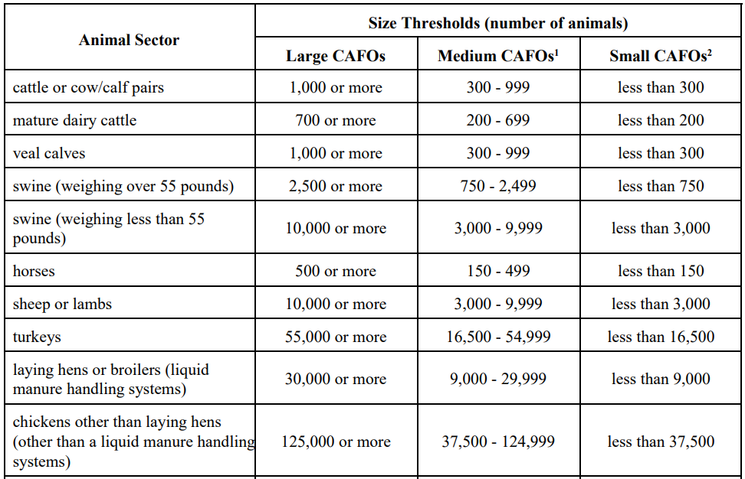
What is a CAFO?
Common Questions (NEPA)
  https://www3.epa.gov/npdes/pubs/sector_table.pdf
  A Large CAFO confines at least the number of animals described in the table below. A Medium CAFO falls within the size range in the table below and either: • has a manmade ditch or pipe that carries manure or wastewater to surface water; or • the animals come into contact with surface water that passes through the area where they’re confined

Slide 20
What if the producer has already started the project?
Common Questions (NEPA)
Consult FSA before any action is taken to start the project
  If the project has already started, FSA may not be able to complete a proper review and may therefore have to deny the request

Slide 21
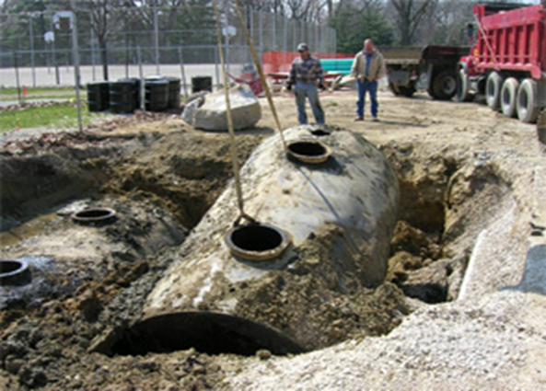

Due Diligence
The Due Diligence Process
Recognized Environmental Conditions
Roles and Responsibilities
Common Due Diligence Questions
Notes:
21

Slide 22
Due Diligence
What is due diligence?
Environmental due diligence is a process that evaluates the environmental conditions and risks of a property or land, such as soil and/or groundwater contamination. It is a form of proactive environmental risk management and liability protection. One of the main reasons agricultural lenders complete due diligence prior to making a loan on real estate is to assess whether contingent environmental liabilities may impair a borrower’s ability to repay the loan or make it difficult or impossible for the lender to sell or securitize the loan or possibly causing the lender to become responsible for the cleanup of hazardous waste or petroleum contamination.

Slide 23
Due Diligence Process (FSA)

Slide 24

Underground Storage Tanks
Recognized Environmental Conditions

Slide 25
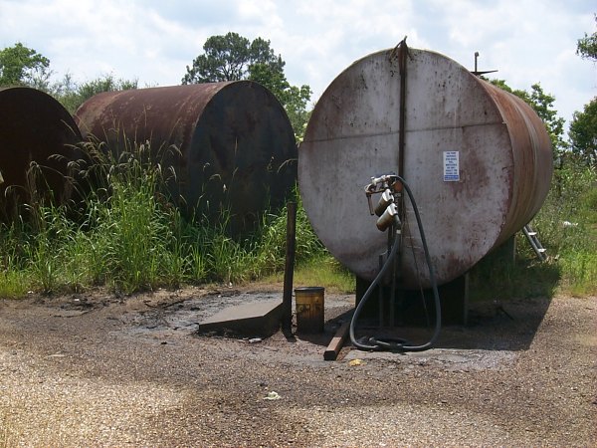
Above Ground Storage Tanks
Recognized Environmental Conditions
Is this a REC?

Slide 26
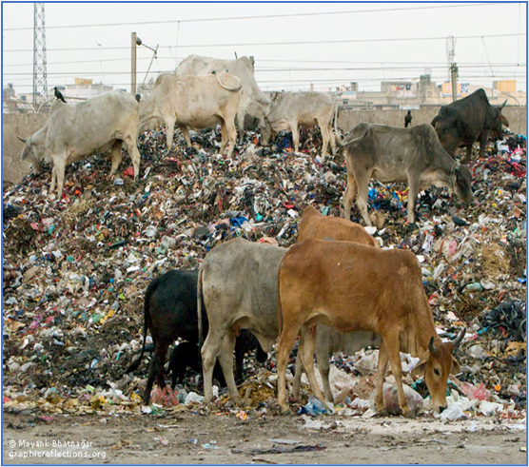
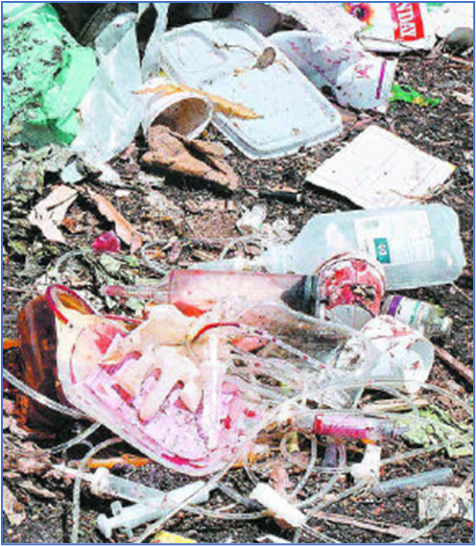
Landfills
Recognized Environmental Conditions

Slide 27
Underground Storage Tanks
Recognized Environmental Conditions
Leaking Underground Storage Tanks (LUST) often cause the release of a fuel product that can contaminate surrounding soil, groundwater, surface water, or indoor air.
Regulated and unregulated tanks require a site visit to identify USTs
A database search is needed to identify LUSTs within 0.5 miles of the site.

Slide 28
Roles and Responsibilities (Due Diligence)
Guaranteed Lenders must complete due diligence for loan guarantees using real estate as security.
  FSA-2211 "Application for Guarantee" includes certification that a due diligence review has been completed.
  Attach the review if concerns are identified.

Slide 29
Roles and Responsibilities (Due Diligence)
Contractors and/or Lender Staff
  Can be utilized for the due diligence documentation
  May use the:
    ASTM Transaction Screen Questionnaire;
    The FSA-851; or
    Any other similar form approved by their regulator

Slide 30
Roles and Responsibilities (Due Diligence)
State Environmental Coordinators
  Oversee requirements related to due diligence
  Train FSA Staff on due diligence for direct loans (FSA-851 Environmental Risk Survey Form).
Appraisers
  Typically, are not environmental professionals.
  Must document environmental concerns in the appraisal report according to the Uniform Standards of Professional Appraisal Practice.

Slide 31
Who is Responsible?
Common Questions (Due Diligence)
  Lenders are responsible for completing the FSA-851 or similar form for guaranteed loans with real estate serving as primary security.
  Lenders should generally complete this review prior to submitting the application because the lender must certify on the FSA-2211 “Application for Guarantee” that they’ve completed a site visit and indicate whether any environmental hazards are present.

Slide 32
When must lenders notify FSA of the review?
Common Questions (Due Diligence)
The environmental due diligence review (FSA-851 or similar form) addresses the suitability of the loan security
  Lenders are not required to submit that due diligence review to FSA unless their review indicates that potential hazards may exist.
  If lenders failed to complete that review and there is a loss claim, that loss claim may be reduced or denied if environmental hazards contributed to the loss.

Slide 33
Joint Financing: Should the Lender complete their own Due Diligence?
Common Questions (Due Diligence)
While lenders are encouraged to work collaboratively with FSA in joint financing situations, the lender should still complete their own due diligence review on the FSA-851 or other similar form.

Slide 34
Who is responsible for what?
Common Questions
Lender | Applicant | FSA
Prescreen applicants based on potential loan purposes | Complete and submit AD-1026 form | Coordinate the process and compile all documentation
Contact FSA prior to starting any construction or project | Provide the lender, FSA, or consulting agencies with all requested permits, plans, and documentation | Conduct consultation with outside agencies as needed
Conduct site visit for due diligence purposes | Pay costs associated with the environmental review | Inform applicant and lender of specific items needed case by case
Inform the borrower early of the need for the environmental review | Do not start construction or project prior to approval | Respond to public comments (if applicable)
Coordinate with the borrower to make sure FSA receives necessary documentation | Publish notices in the newspaper as directed by FSA | Prepare, sign, and make final decisions on approval/disapproval of NEPA documents

Slide 35
Questions?

