Slide 1
June 2023 Guaranteed Lender Training

Slide 2
Welcome
Presenters: Steve Ford, Sr. Loan Officer
Heather Laubenthal, Sr. Loan Officer
Q&A Moderator: Matt Henderson, Sr. Loan Officer
Microsoft Teams Live Event
type questions into Q&A
Recording, Slides, Q&A will be posted to website
USDA is an equal opportunity provider, employer, and lender

Slide 3
Applications
Lender Type / Loan Amount
EZ Guarantee
PLP
CLP
SEL
To $125K*
$125K* +
Micro Lender to $50K*
SEL to $100K*
*EZ Dollar amounts based on outstanding principal. SEL dollar amounts based on transaction amount.
USDA is an equal opportunity provider, employer, and lender

Slide 4
Applications
EZ Guarantee
Form FSA-2211
If necessary: Environmental information
Lenders will collect and maintain any other supporting documentation according to their normal lending practices for loans this size
USDA is an equal opportunity provider, employer, and lender

Slide 5
Applications
PLP
Form FSA-2211
Narrative (including location of farmed land)
Items agreed to in CMS
If necessary: Environmental information
USDA is an equal opportunity provider, employer, and lender

Slide 6
Applications
CLP
Submit to FSA (always) | Form FSA-2211 Narrative (including location of farmed land) Balance Sheet Cash Flow Budget
Submit to FSA when needed | Entity information Balance sheet from each member Environmental Construction plans
 | Up to $125,000 | Over $125,000
Maintain in file | Credit Report | Credit Report Verification of Debts (over $5,000) Verification of Non-farm income 3-year financial history Proposed Loan Agreements
USDA is an equal opportunity provider, employer, and lender

Slide 7
Applications
SEL – What do I submit to FSA?
Always | Form FSA-2211 Narrative (including location of farmed land) Balance Sheet Cash Flow Budget Credit Report
If over $125K | Verification of Debts (over $5,000) Verification of Non-farm income 3-year financial history 3-year production history Proposed loan agreement (if any)
If needed | Entity information Balance sheet from each member Environmental Construction plans
USDA is an equal opportunity provider, employer, and lender

Slide 8


Loan Narrative Important Points
Refer to Exhibit 4.5 in 2-FLP for a guide on how to construct a loan narrative. Additionally, a sample narrative is forthcoming and will be included in the handbook soon.
USDA is an equal opportunity provider, employer, and lender

Slide 9
LOAN NARRATIVE
Why a comprehensive narrative is so important -
Reduces requests for additional information from FSA staff
Only source of background information FSA has on the applicant
Covers FSA eligibility beyond the checklist questions
USDA is an equal opportunity provider, employer, and lender

Slide 10
Three Most Important Items to Include:
Description of the operation
Credit History
Test for Credit (why the guarantee is needed)
USDA is an equal opportunity provider, employer, and lender

Slide 11
Description of the Operation:
Questions to be answered in the narrative:
  Are they the operator?
    Who is the legal operator?
    Who is the physical operator?
  Is the operation a farm?
    What commodities or products do the applicant’s produce?
    Is the commodity an agricultural product?
  Is the operation family size?
    How much labor is provided by family members? Number of owner families involved
    Size (quantity, dollars) compared to typical family farm for the area
    Production quantity (Acres farmed, head raised/sold)
    Any special factors (Growth plans, past size vs. current)
USDA is an equal opportunity provider, employer, and lender

Slide 12

Credit History
Don’t be silent on credit history
If negative - discuss late payments, low scores
  How these were beyond borrower’s control
  Why this is no longer a concern
    Example: Bob Farmer and Betty Farmer have a good relationship with ABC Savings Bank. They have had some credit issues in the past. Bob’s credit score is 600 and Betty’s is 595. 5 years ago, Bob and Betty had twin girls prematurely and required significant medical care. This led to bills getting past due and medical debt. Since then, Bob and Betty have worked hard to improve their financial standing. They have been paying extra on debt and regularly communicating with the bank. Most of the medical debt has been paid off and their credit scores are showing marked improvement.
What about positive? (if there are no late payments, etc.)
  If positive, can be brief - just note saying “credit history is strong with no history of late payments, and a credit score of …”
USDA is an equal opportunity provider, employer, and lender

Slide 13
Test for Credit (Why do you need the guarantee)
Must be based on some weakness: cash flow, new enterprise, irregular performance history, rapid expansion, poor market, net worth, current capital position, limited collateral, new operator
Consider other assets, including personal assets
Selling on secondary market alone is not adequate. How do secondary market rates and terms necessary for operation’s success? Need to show benefit to borrower.
USDA is an equal opportunity provider, employer, and lender

Slide 14
Examples:
Acceptable: “Repayment margin below lender’s credit standards. Projected cashflow indicates 1.05 Debt Service Margin (DSM) which falls below lender’s standard of 1.20 DSM.”
Acceptable: “Capital position does not meet lender’s credit standards. 65% debt / equity higher than lenders standard of 50%.”
Acceptable : “Without a guarantee to sell on the secondary market, the lender is not able to offer a fixed interest rate which will benefit the customer’s repayment capacity in the long term as well as reduce the overall risk in the future of potential rate increases. This will also allow the customer’s repayment capacity to fall close to internal lender standards.”
USDA is an equal opportunity provider, employer, and lender

Slide 15
Other items to be addressed in the narrative:
Location of land farmed
Loan proposal
Any other eligibility issues
5 C’s of Credit
Capital Analysis
Capacity Analysis
Character Analysis
Collateral Analysis
Loan Conditions and Servicing Plan
USDA is an equal opportunity provider, employer, and lender

Slide 16
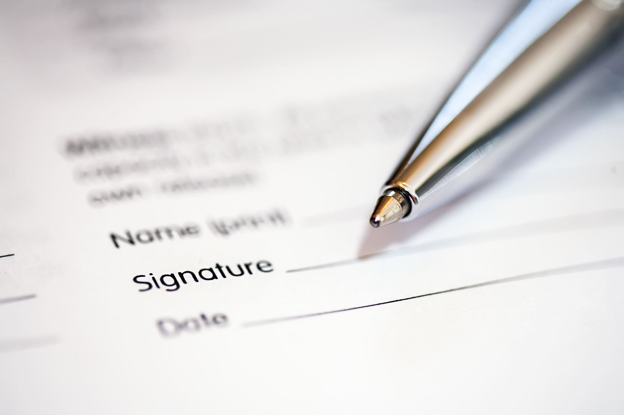
Signatures
USDA is an equal opportunity provider, employer, and lender

Slide 17
What if FSA receives an application without all signatures?
Signatures
FSA: Application Incomplete. Notify lender of signatures needed. Continue to process application
May approve subject to signatures if unable to obtain signatures (submit through USDA Web Forms)
A signed version of the application must always be submitted prior to closing.
USDA is an equal opportunity provider, employer, and lender

Slide 18
Signatures
2-FLP, Par. 3
What types of signatures are acceptable on forms from guaranteed lenders and applicants?
Hard copy form
Scanned / faxed copy of a handwritten signature
Emailed form with digital signature
Form submitted through USDA online services (eForms)
How to I verify that electronic or digital signatures are acceptable?
have been e-mailed by a lender known to the agency, from a recognized e-mail address
identify the individual signing the document
identify the software vendor used to execute the digital signature
provide a method to confirm the authenticity of the signature.
USDA is an equal opportunity provider, employer, and lender

Slide 19
Signatures
What is not acceptable as a signature?
Digital images of an individual’s signature (jpg or similar) pasted in the signature block, without any digital signature validation
Τyped names or initials on the signature line.
USDA is an equal opportunity provider, employer, and lender

Slide 20
Signatures
What Guaranteed Loan forms may be accepted or signed electronically?
All Guaranteed forms may be accepted or signed electronically
A hard copy is not required from the lender
USDA is an equal opportunity provider, employer, and lender

Slide 21
FSA Best Practices
Guaranteed Application Best Practices
Ensure the 1st incomplete letter contains all items
Email the lender a complete list items needed ASAP. Follow up with a letter.
If any additional question arise, follow up immediately with the lender, preferably by phone, or email.
Communication is crucial
Obtain forms for borrower / lender when possible.
USDA is an equal opportunity provider, employer, and lender

Slide 22
Lender Best Practices
Guaranteed Application Best Practices
Use the checklists on Form FSA-2211 available to ensure all items are included
If anything is unique about the proposed application – call FSA first
Communication is crucial
Let us know where we are inconsistent. We can only solve the problems we know about.
Use the Lender Narrative Guide and sample (coming soon)
USDA is an equal opportunity provider, employer, and lender

Slide 23
When is physical documentation needed from the lender to verify questions that arise during the review of the application?
Guaranteed Application Best Practices
Cover as much as possible with specific, targeted questions. Limit requests for documents.
Consider the nature of the transaction, the parties involved, and the level of risk.
Avoid requesting a balance sheet or cashflow when not required for an application (PLP, EZ Guarantee)
USDA is an equal opportunity provider, employer, and lender

Slide 24
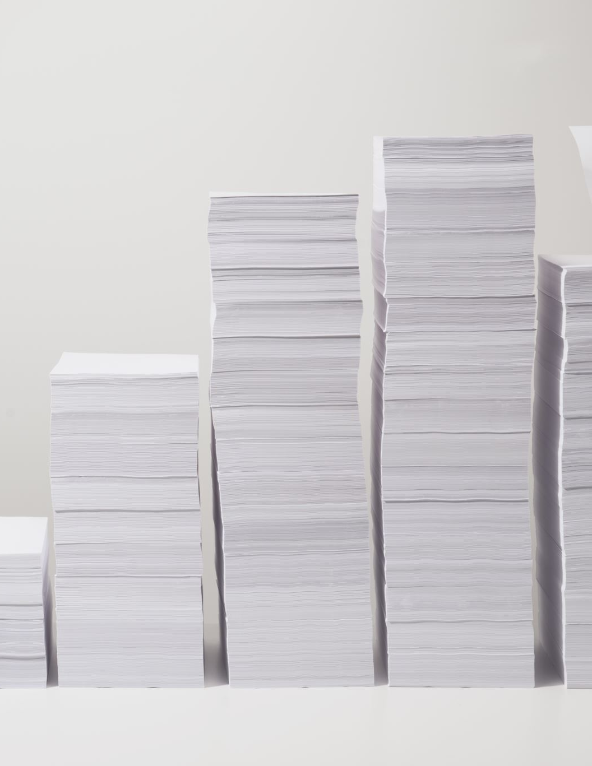
Guaranteed Application Best Practices
Following can typically be handled with a call or email and documented in the FSA’s approval narrative (physical documentation generally not necessary):
Projected yields seem high
Projected prices seem high
Some expenses depart from history
Debts to be refinanced unclear
USDA is an equal opportunity provider, employer, and lender

Slide 25
Guaranteed Maximum Interest Rates
Maximum interest rate rules were updated in March 2022 (2-FLP, Paragraph 135)
  Replaced the use of the 3-month LIBOR with the SOFR and adjusted the related allowable mark-up
  Removed the separate set of rules for lenders who use risk-based pricing
USDA is an equal opportunity provider, employer, and lender

Slide 26
Guaranteed Maximum Interest Rates
At the time of loan closing or restructuring, the interest rate charged by the lender cannot exceed one of the following as applicable:
  For loans with variable rates or rates fixed for less than 5 years: 6.75% above the prior business day’s SOFR rate
  For loans with rates fixed for 5 or more years: 5.5% above the prior business day’s 5-year Treasury note rate
In the event that the SOFR falls below 1.75%, each of the maximums above may be increased by an additional 1%
USDA is an equal opportunity provider, employer, and lender

Slide 27
Guaranteed Maximum Interest Rates
Lender’s proposed interest rate should be reviewed at the time of approval, but especially at closing prior to issuing the guarantee
If the proposed rate increases between the time of approval and closing:
  Lender should document that the plan is still feasible with the increased rate
  FSA should review the rate to ensure it doesn’t exceed the maximums outlined in 2-FLP, Paragraph 135 and document that in the file
  Generally speaking, a new conditional commitment does not need to be issued due to a slight interest rate change
USDA is an equal opportunity provider, employer, and lender

Slide 28
Guaranteed Maximum Interest Rates
What if the lender’s proposed rate exceeds the allowable maximums?
  If the loan hasn’t been approved yet: The lender should be informed that the application for guarantee can’t be approved with the proposed rate.
  If the loan has been approved, but the rate on the promissory note exceeds the maximums: The lender should be informed that FSA can’t issue the guarantee unless the rate is adjusted.
USDA is an equal opportunity provider, employer, and lender

Slide 29
Loan Purpose
What are considered to be allowable processing and marketing costs?
  Purchase of co-op stock to allow a producer to market their specific product
  Costs for the initial processing of commodities produced by the applicant’s farm (i.e. canning tomatoes for sale, packaging maple syrup, candling and packaging eggs for sale, etc.)
Where do we draw the line?
  Majority of the commodities being processed must be produced by the applicant’s farming operation
  When comparing the revenues and expenses for the farm and nonfarm (processing) operations, the farm should generally be the larger share
USDA is an equal opportunity provider, employer, and lender

Slide 30
Loan Purpose
Can OL funds be used for the purpose of providing working capital?
  Yes, this can be covered by one of the following OL purposes
    Payment of costs associated with reorganizing a farm
    Other farm needs
Limitations
  The amount should be limited to working capital appropriate for the type and size of operation as well as the borrower’s financial condition.
  The lender must control and document the disbursement of funds to ensure they are only used for authorized OL purposes.
USDA is an equal opportunity provider, employer, and lender

Slide 31
Loan Purpose
What is/isn’t allowed with regard to using LOC funds for debt repayment?
Allowed
  Payment of scheduled, non-delinquent term debt payments
  Payment of debts incurred for the current operating cycle
NOT Allowed
  Payment of carry-over debt from a prior operating cycle
USDA is an equal opportunity provider, employer, and lender

Slide 32
How do we evaluate if a particular debt is carry-over?
Loan Purpose
Is it a delinquent term debt?
Is it an operating debt/expense incurred for a prior operating cycle?
Are there adequate inventories on hand to cover the carry-over amount?
USDA is an equal opportunity provider, employer, and lender

Slide 33
Consistency
Consistency:
FSA – talk to your neighbors!
Lenders – let us know – we can’t solve a problem we are unaware of. (List of STO Guarantee Contacts)
USDA is an equal opportunity provider, employer, and lender

Slide 34
Future Training
Ongoing Training ideas:
Joint Financing with FSA
Guaranteed basic training for newer hires
Guaranteed Servicing Responsibilities
What would you recommend?
  Steven.Ford2@usda.gov
USDA is an equal opportunity provider, employer, and lender

Slide 35
Questions
USDA is an equal opportunity provider, employer, and lender

