Slide 1
September 2023 Guaranteed Lender Training

Slide 2
Welcome
Presenters: Paul B. Peterson, Sr. Loan Officer, Direct Loan Making and Funds Management Branch
Q&A Moderators: Matt Henderson and Steven Ford, Sr. Loan Officers, Guarantee Loan Making Branch
Microsoft Teams Live Event: Please type your questions into the Q&A
Recording, Slides, Q&A will be posted to website
USDA is an equal opportunity provider, employer, and lender

Slide 3
Topics
FSA Direct Loans
Operating Loans
Farm Ownership Loans
Partnering with FSA

Slide 4
Exceptions
There are exceptions for the material being covered. Exceptions allow for flexibility in the administration of the topics presented and equitable delivery to a large variety of farming operations. We will be focusing on typical applications of FLP programs. If you have a specific scenario, please reach out to your local FSA Farm Loan team.

Slide 5
FSA Direct Operating Loans
Operating Loans
Microloan
Term Operating
Annual Operating

Slide 6
FSA Direct Operating Loans
Direct OL purposes are addressed in 3-FLP par. 201
  Reorganizing a farm
  Chattel and other purchases
  Annual Farm Operating Expenses
  Refinancing Farm-Related Debts
  Minor Real Estate Repairs or Improvements
  Principal and Interest Payments
  Other Farm Needs
  Land and Water Development
  Loan Closing Costs
  Occupational Safety and Health Act of 1970 Compliance
  Training Costs

Slide 7
Loan Limits
FSA Direct Operating Loans
Microloans
Total outstanding principal balance, for direct operating loan debt, not to exceed $50,000
Direct Operating Loans
Total outstanding principal balance, for direct operating loan debt, not to exceed $400,000

Slide 8
Terms
FSA Direct Operating Loans
  Annual Operating Loans
    Not to exceed 24 months from the date of the note
    Repayment is scheduled when income is planned to be available.
  Term Operating Loans
    Maturity is limited to 7 years from the date of the note
    Can be amortized over 21 years
    May be limited to useful life of security

Slide 9
Rates
FSA Direct Operating Loans
  Established monthly (5.125%)
  Fixed for the life of the loan
  The lower of the interest rate in effect at the time of approval or loan closing
  Limited resource rate is used if a feasible plan cannot be developed at the regular interest rate. (Continuation of the limited resourse rate is subject to review at least every two years) (5%)
  Microloan rate to a beginning farmer or veteran rancher may choose the microloan rate (5%) or regular rate

Slide 10
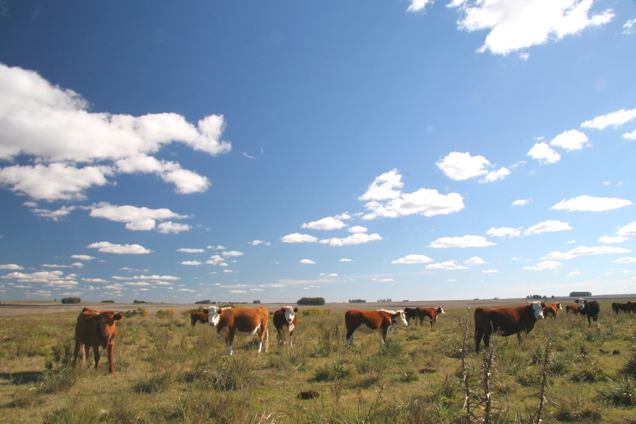
Eligibility/Limitations Include
FSA Direct Operating Loans
  May close an OL in no more than seven calendar years
    May qualify for a 2 year extension, subject to conditions
    Microloans made to a beginning farmer or a veteran farmer are not counted toward this limitation.
  FSA borrower must be the operator.
This Photo by Unknown Author is licensed under CC BY-SA

Slide 11
FSA Direct Farm Ownership Loans
Farm Ownership
Regular
Down Payment
Microloan
Joint Financing
USDA is an equal opportunity provider, employer, and lender

Slide 12
Partnership
FSA encourages joint financing arrangements to meet the financing needs of our farmers and ranchers.
This is commonly utilized with the Farm Ownership program.
It is possible to utilize the Direct Farm Ownership program and Guarantee Loan Program for the same transaction.
USDA is an equal opportunity provider, employer, and lender

Slide 13
Uses
FSA Direct Farm Ownership Loans
Uses are addressed in 3-FLP par. 131
  Farm Purchases
  Capital Improvements
  Soil and Water Conservation and Protection
  Loan Closing Costs
  Refinance Bridge Loan

Slide 14
All Farm Ownership Loans
FSA Direct Farm Ownership Loans
Cannot be used to refinance debt except bridge loans in accordance with 3-FLP par. 131F
FSA borrower must be the owner-operator of the farm financed by FSA
Have not had a direct FO loan outstanding for more than a total of 10 years prior to the date the new FO loan is closed
The lower of the interest rate in effect at the time of approval or loan closing
Security must include the real estate being purchased or improved

Slide 15
All Farm Ownership Loans
Federal statute requires three years of participation in the business operations of a farm to be eligible for FSA Direct Farm Ownership loans. This statute applies to all FSA Direct FO applicants including those applicants defined as beginning farmers. However, statute also allows for limited substitutions (such as education or business experience) of a portion of the three years, and in some scenarios all three years.
All farm ownership loans are fully amortized, balloon installments are not authorized.

Slide 16
Regular
FSA Direct Farm Ownership Loans
Total loan and outstanding principal balance not to exceed $600,000
Term of the loan can not be more than 40 years
Limited resource rate is used if a feasible plan cannot be developed at the regular interest rate. (Subject to review at least every two years)
Requires a lien on non-essential assets
Requires additional security, if available
Direct
Total outstanding principal balance not to exceed $600,000

Slide 17
Micro Loans
FSA Direct Farm Ownership Loans
Total outstanding principal balance not to exceed $50,000
Limited resource rate is used if a feasible plan cannot be developed at the regular interest rate. (Subject to review at least every two years)
No lien required on non-essential assets
Does not require FSA obtain additional security

Slide 18
Joint Financing
FSA Direct Farm Ownership Loans
Total loan and outstanding principal balance not to exceed $600,000
Term of the loan not to exceed 40 years
Limited resource rate is used if a feasible plan cannot be developed at the regular interest rate. (Subject to review at least every two years) (5%)
Requires a lien on non-essential assets
Requires FSA to obtain additional security, if available

Slide 19

Joint Financing
FSA Direct Farm Ownership Loans
If the amount of the Agency’s loan does not exceed 50 percent of the total amount financed, the interest rate is 2% below the regular rate with a floor of 2.5% (3%)

Slide 20
Down Payment
FSA Direct Farm Ownership Loans
Loans will not exceed 45 percent of the lesser of:
  The purchase price,
  The appraised value of the farm to be acquired, or
  $667,000;
Maximum financing is 95% of the purchase price
Applicant must be a beginning farmer, socially disadvantaged farmer, or veteran farmer

Slide 21
Down Payment
FSA Direct Farm Ownership Loans
Term of FSA’s loan not to exceed 20 years
The interest rate is 4% below the regular rate with a floor of 1.5% (1.5%)
No lien required on non-essential assets
Does not require FSA obtain additional security
The participating lender must amortize the loan over 30 years and the loan can not balloon before year 20

Slide 22
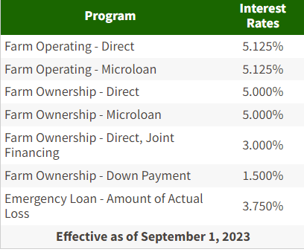
Example
Real Estate Financing Example
  Joe Farmer has a purchase
  agreement to buy 100 acres of
  cropland for $1,400,000. ABC Bank,
  Mr. Farmer’s lender, is not able to
  financing the purchase with or
  without a guaranteed loan alone. They
  have jointly contacted the FSA Office to
  see what potential options they would have.
  ABC Bank’s interest rate is 7.00% and the lender
  is able to do a term of 30 years.

Slide 23
Scenario 1: Non-SDA, Beginning, or Veteran Farmer
Real Estate Financing Example
Direct Farm Ownership Loan, Regular Rate
 | Loan Amount | Percentage of Purchase | Annual Payment
Joe Farmer | $220,000 down payment | 15.7%
ABC Bank | $580,000 | 41.4% | $46,740
FSA Regular FO | $600,000 | 42.9% | $34,967
Total | $1,400,000 |  | $81,707

Slide 24
Scenario 1: Non-SDA, Beginning, or Veteran Farmer
Real Estate Financing Example
  FSA loan would have an interest rate of 5% and a term not to exceed 40 years. FSA would be in a second lien position on the real estate.
  The lender would be in a first lien position. The lender could also request a 90% guaranteed loan for $580,000.
  A one time guarantee fee of $7,830 ($580,000x90%x1.5%) would be assessed.

Slide 25
Scenario 2: Non-SDA, Beginning, or Veteran Farmer
Real Estate Financing Example
Joint Financing Farm Ownership Loan, Participation Rate
 | Loan Amount | Percentage of Purchase | Annual Payment
Joe Farmer | $200,000 down payment | 14.2%
ABC Bank | $600,000 | 42.9% | $48,352
FSA | $600,000 | 42.9% | $25,958
Total | $1,400,000 |  | $74,310
Notes:
7397

Slide 26
Scenario 2: Non-SDA, Beginning, or Veteran Farmer
Real Estate Financing Example
  FSA loan would have an interest rate of 3% and a term not to exceed 40 years. FSA would be in a second lien position on the real estate.
  The lender would be in a first lien position. The lender could also request a 90% guaranteed loan for $600,000.
  A one time guarantee fee of $8,100 ($600,000x90%x1.5%) would be assessed.

Slide 27
Scenario 3: SDA, Beginning, or Veteran Farmer
Real Estate Financing Example
Down Payment Farm Ownership Loan
 | Loan Amount | Percentage of Purchase | Annual Payment
Joe Farmer | $70,000 down payment | 5%
ABC Bank | $1,029,850 | 73.6% | $82,992
FSA | $300,150 | 21.4% | $17,483
Total | $1,400,000 |  | $100,475

Slide 28
Scenario 3: SDA, Beginning, or Veteran Farmer
Real Estate Financing Example
  FSA loan would have an interest rate of 1.50% and a term not to exceed 20 years. FSA would be in a second lien position on the real estate.
  The lender would be in a first lien position. The lender could also request a 95% guaranteed loan for $1,029,850.
  No guarantee fee will be assessed.

Slide 29
Working with FSA
Best Practices
  Lenders and FSA are partners not competitors
    Common goals
  Communication
    Reach out to your local FSA farm loan team with any questions, hypothetical, or specific scenarios
    Policies do change
  Build a relationship with your local FSA farm loan team

Slide 30
Working with FSA
Best Practices
  Joint meetings with the applicant, lender, and FSA prior to applying for a loan can helpful
    Goals
    Direction
    Process
    Expectations
  Planning ahead is crucial
    Appraisals
    Surveys

Slide 31
Questions
USDA is an equal opportunity provider, employer, and lender

