Slide 1
Welcome to the briefing on the new Farm Loan Programs rule!
“Enhancing Program Access and Delivery for Farm Loans”
The event will begin shortly

Slide 2
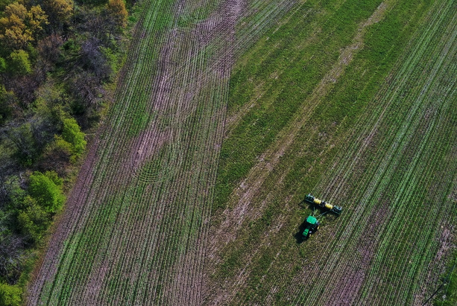


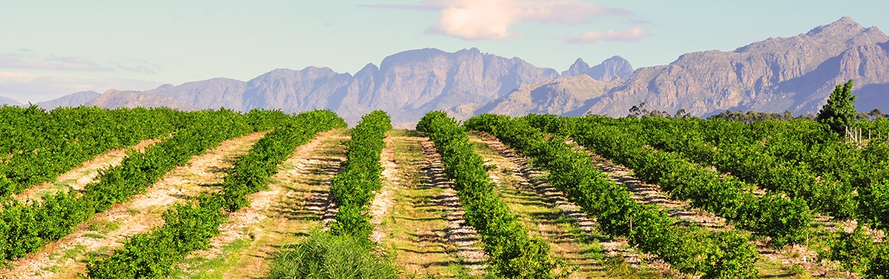
Farm Loan Programs |
August 8, 2024
Enhancing Program Access and Delivery for Farm Loans
Building Financial Freedom and Farm Resilience

Slide 3

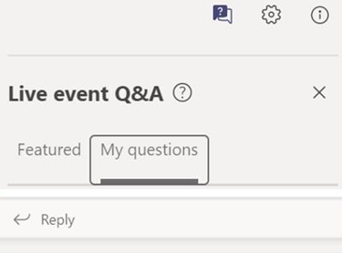
Microsoft Teams Live Events
Instructions for the live event are listed below.
One–Direction Broadcast: As an attendee, you are not able to share your audio or video feed.
Closed Captioning: To turn on closed captions, click on the three-dot menu icon at top of your screen. A sub menu should appear with various options. Click on the option titled “Turn on Live captions”
Meeting Recording: This event is being recorded. A copy of this recording will be available on the FLP Training SharePoint.
Q&A: Participants may ask questions during the Live Event using the Q&A feature. To see all questions posted, toggle between the Featured and My Questions tab.

Slide 4
Farm Loan Program Updates: Building Farm Resilience and Financial Freedom (LINK)

Slide 5
Key Dates
August 8: Rule Publication Date
Start of Public Comment Period
September 25: Rule Effective Date
October 7: End of Public Comment Period
This rule contains over 40 changes, clarifications, and corrections to FSA’s loan programs.

Slide 6




Enhancing FLP Rule Key Themes
The central policy improvements in the Enhancing FLP rule were driven by years of feedback from countless employees, representatives, lenders, advocates, leadership, and producers.
The rule advances changes based on the following core objectives:
PROVIDE FINANCIAL FREEDOM
EXPAND OPPORTUNITIES
INCREASE
RESILIENCE
PROVIDE EQUITABLE
ACCESS
+ Data-Driven Enhancements
+ Common-Sense Changes

Slide 7



Overview of Rule Changes

Slide 8
Specific Changes to Guaranteed Loan Program
While most changes in the rule affect the direct loan program, there are a handful of smaller but important changes to the guaranteed loan program
  Expanded opportunities for subordinations to allow refinancing of the lender’s own debt
  No longer required to take a lien on all assets to facilitate a restructure that includes a balloon installment repayment plan
  All lenders must receive FSA concurrence of eligibility of new borrowers involved in a transfer and assumption
Enhancements as a result of input for lenders, customers, and staff

Slide 9
Notable Rule Changes
This briefing will highlight three significant changes to Farm Loan Programs in the Enhancing FLP rule:
Distressed Borrower Set-Aside (DBSA) Program
Collateral Requirements
Loan Repayment Terms

Slide 10
Notable Rule Changes: Distressed Borrower Set-Aside (DBSA)
Provides a quick resolution to temporary borrower distress
Operates similarly to the existing Disaster Set-Aside (DSA) program
Does not require natural disaster impacts
Defers payment at a reduced interest rate (0.125%)
Preserves future Primary Loan Servicing opportunities for borrowers
DBSA Program Considerations:

Slide 11
Notable Rule Changes: Additional Security
Reduces additional security requirements
Decreases security margin requirement to 125% from 150%
Removes additional security requirements for certain loans
Primary residence will not be required as additional security
Expands opportunities for release of security as principal is paid down
Primary Changes to Collateral Requirements:

Slide 12
Notable Rule Changes: Repayment Terms
Expands opportunity for Direct loan customers to budget for savings
Offers maximum term lengths
Offers interest-only first year payments and other flexible repayment terms
Empowers producers to choose preferred terms
Primary Changes to Loan Repayment Terms:

Slide 13
Enhancing FLP Rule – By the Numbers
The rule is projected to:
Time Savings
Profits
Flexibility
Recovery
Save 51,000 total hours between staff (44,000) and customers (7,000)
Free up $88M in cash for 6,000 customers annually
Free up $257M in equity for 8,000 customers annually
Provide a set-aside option for up to 3,000 eligible customers

Slide 14






Budgets and Terms
The changes to repayment terms and operating plans are more focused on Direct loans than Guaranteed loans but do allow for similar considerations in Guaranteed lending.
Summary of Impacts:
Commercial lenders will continue to be valued partners who work cooperatively with FSA to serve farmers and ranchers, as they are today.
The rule ensures the consideration of the use of terms that allow reasonable progress towards long-term financial goals.
To be reasonable, commercial loans must simply provide the opportunity to make progress towards those long-term needs (something that is already happening with most commercial loans), the rule does not require a Guaranteed loan to have the same margin, rates or terms of a Direct loan.

Slide 15

Public Comment
Enhancing Program Access and Delivery for Farm Loans is published as a final rule, but FSA will consider comments in implementation, or for future rule revisions. The rule is open for public comment for 60 days after Federal Register publication.
Public comments can be submitted at www.regulations.gov.
Reminder: The rule will be effective September 25, 2024

Slide 16
Thank you!
USDA is an equal opportunity provider, employer, and lender.

