Slide 1
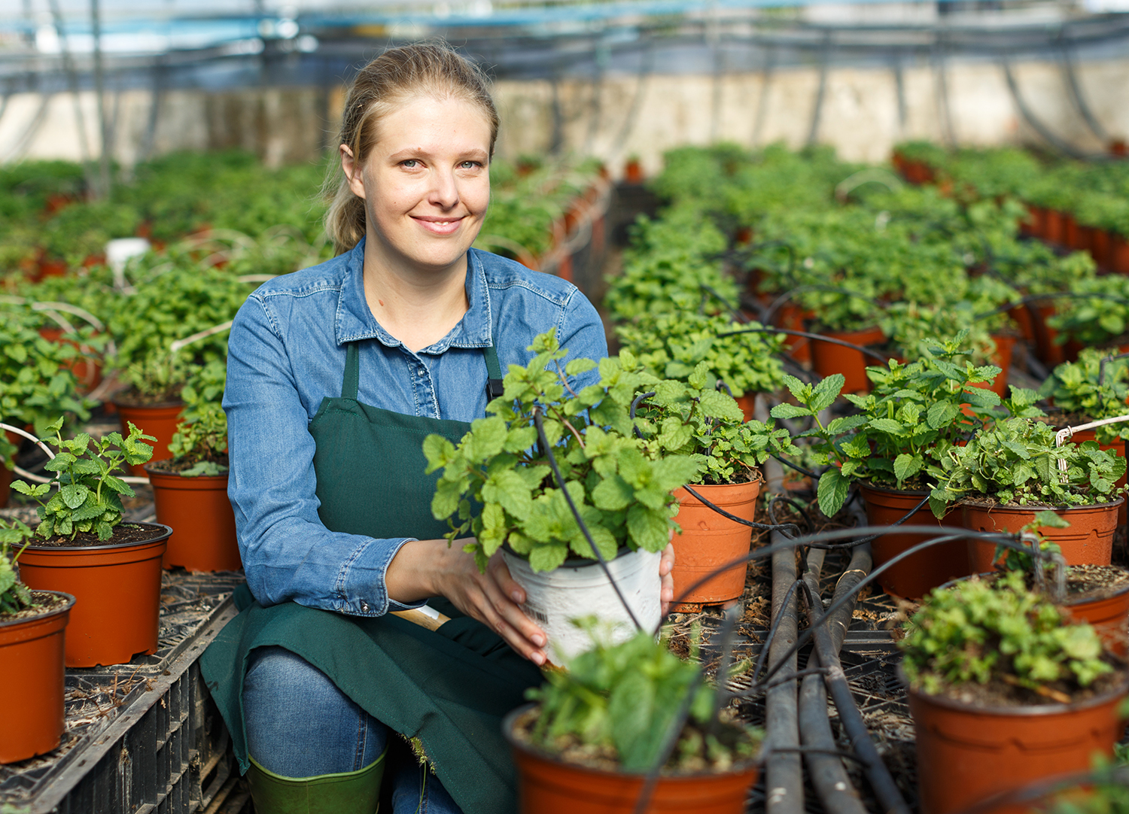

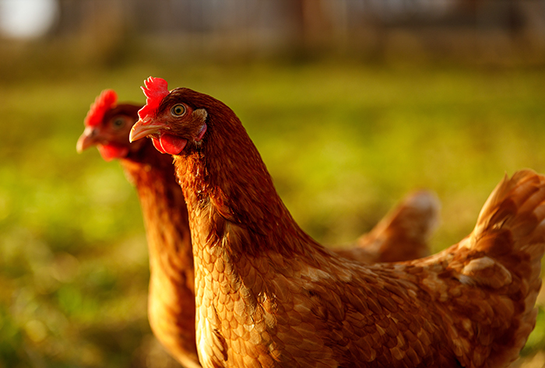
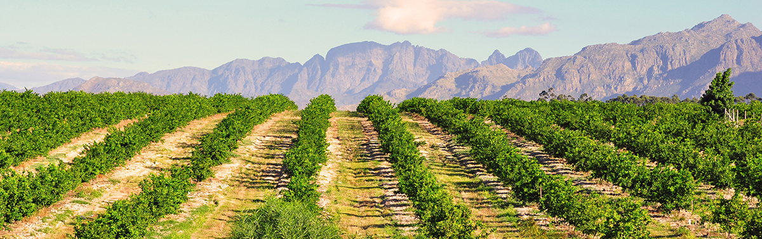
Guaranteed 101 Training

Slide 2
Presenters: Nicole Massey, Sr. Loan Officer, LMD
Heather Laubenthal, Sr. Loan Officer, LMD
Steven Dusek, Sr. Loan Officer, LSPMD
Q&A Moderator: Matt Henderson, Senior Loan Officer, Guaranteed Loan Making
Microsoft Teams Live Event
type questions into Q&A
Recording, Slides, Q&A will be posted to website

Slide 3
What is the Purpose of a Guaranteed Loan?
Enables lenders to extend credit to family farm owners or operators who do not qualify for standard commercial loans.
Benefits beginning farmers and family farmers experiencing financial distress, as well as lending institutions and the local community as a whole
Serves the local community by protecting family farmers and farm-related businesses
Enables lenders to extend conservation credit to some farmers who are not eligible for Guaranteed FO’s or OL’s.

Slide 4
What is the Differences Between a Guaranteed Loan and a Direct Loan
Guaranteed Loans
The lender is FSA’s customer
The interest rate and term is negotiated between the lender and the applicant.
Typically, there is a fee of 1.5% charged to the applicant
The processing time-frame of a complete application can be 14 – 30 calendar days after the loan is determined complete (depending on the lender status).
The lender is responsible for closing and servicing the loan once closed.
The loan funds comes directly from the lender.
Loans are often sold on the secondary market
The lender and applicant complete the Application for Guarantee and submit it to the FSA Center
Direct Loans
The applicant is FSA’s customer
FSA determines the customer’s interest rate and term for the loan
There is no fee charged to the applicant
The processing time-frame of a complete application is 60 calendar days after the loan application is determined complete
FSA is responsible for closing and servicing the loan once closed.
The loan is funded directly by FSA. The money comes from annual Congressional Appropriations received as part of the USDA Budget.
Loans are not sold on the secondary market
The FSA Service Center meets with the applicant to complete the application.

Slide 5
What Guaranteed Loans cannot be used for?
A non-eligible enterprise is a business that does not meet the criteria for a farm loan such as:
Producing exotic animals, birds or aquatic organisms ( there is no established or stable market for them or production)
Produce non-farm animals, birds or aquatic organisms ordinarily used for pets or companionship and not typically associated with human consumption, fiber or draft use.
Products not produced by the farming operation
Processes or markets farm products when majority of the commodities processed or marketed are not produced by the farming operation.

Slide 6

Guaranteed Loan Benefits

Slide 7
Benefits to Applicants Participating in the Guaranteed Loan Program
The program allows Beginning Farmers and Family Farmers experiencing financial distress who otherwise would not qualify for a commercial loan.
Farmers will receive credit at reasonable rates and terms to finance their current operation or to expand their business.
The program will allow a collaboration with farmers and lenders to establish a working relationship before they are eligible for a Commercial Loan.

Slide 8
Benefits to Lenders Participating in the Guaranteed Loan Program
Manage Credit Risk
The program aims to provide lenders with a guarantee against the loss of a portion of the loan in an effort to facilitate credit availability to farmers.
Increase Customers
Encourages lenders to provide affordable financing to farmers who are unable to obtain financing from conventional sources at reasonable rates and terms.
Improve liquidity
By selling loans on secondary market, the lender can free up additional funds to lend to other customers
Manage Interest rate Risk
By selling loans on the secondary market, the lender can offer fixed rates over a longer term.

Slide 9

Classification of Lenders

Slide 10
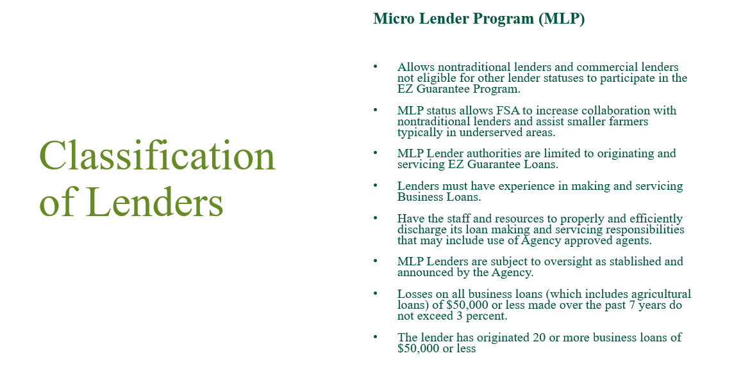

Slide 11
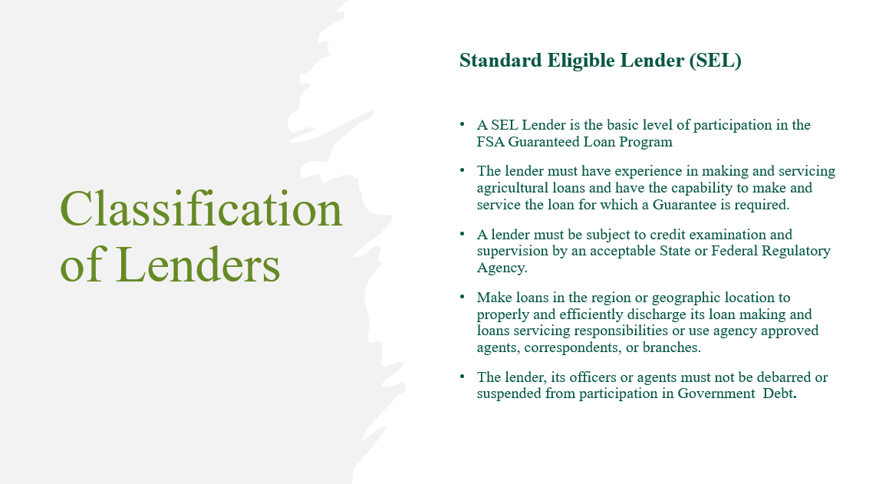

Slide 12
Credit Examination and Supervision
A lender must be subject to credit examination and supervision by an acceptable State or Federal regulatory agency. (7 CFR 762.105(b))
A regulator will typically review of the lender’s asset quality, management practices, financial condition, and compliance with applicable laws and regulations.
Supervision means the regulator has authority to require the lender to make changes to ensure safety and soundness.
Traditional regulators like FDIC, OCC, and Farm Credit Administration meet this standard (see 2-FLP Par. 46 C for a more complete list).
Other regulators may meet this standard but check with FSA first.

Slide 13
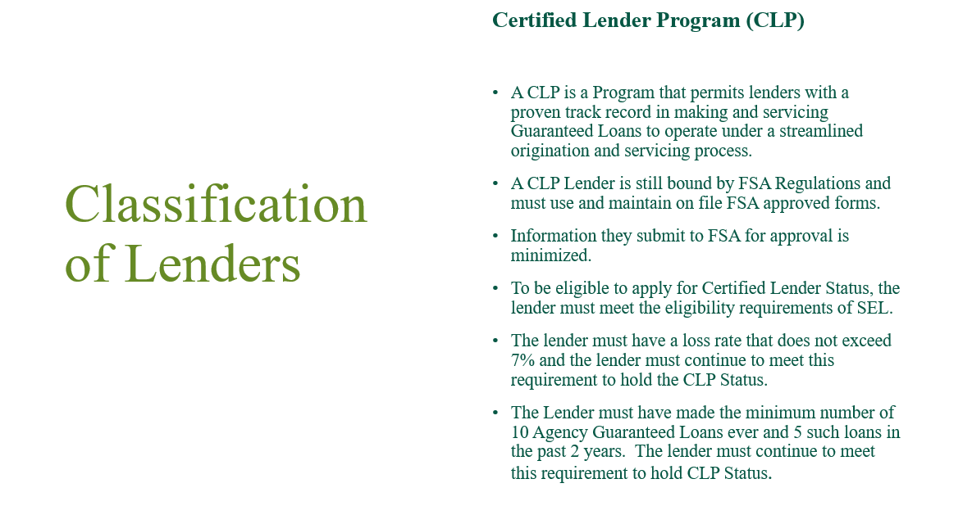

Slide 14
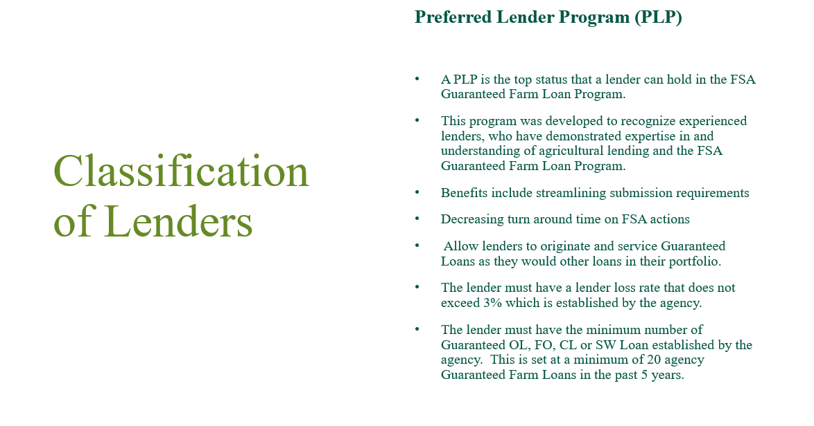

Slide 15
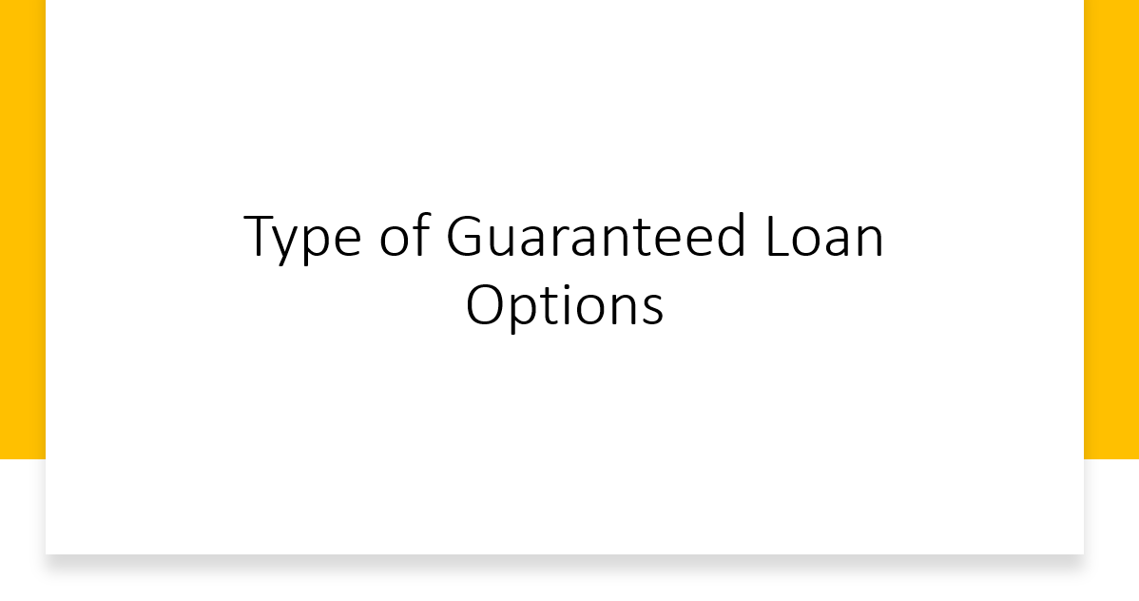

Slide 16
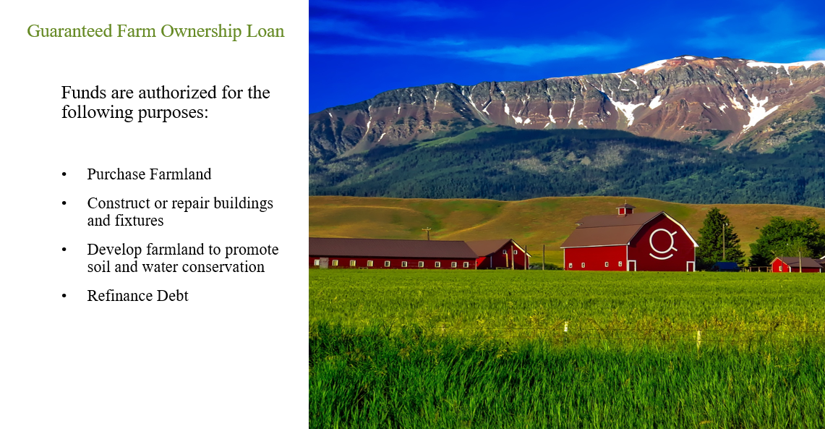

Slide 17
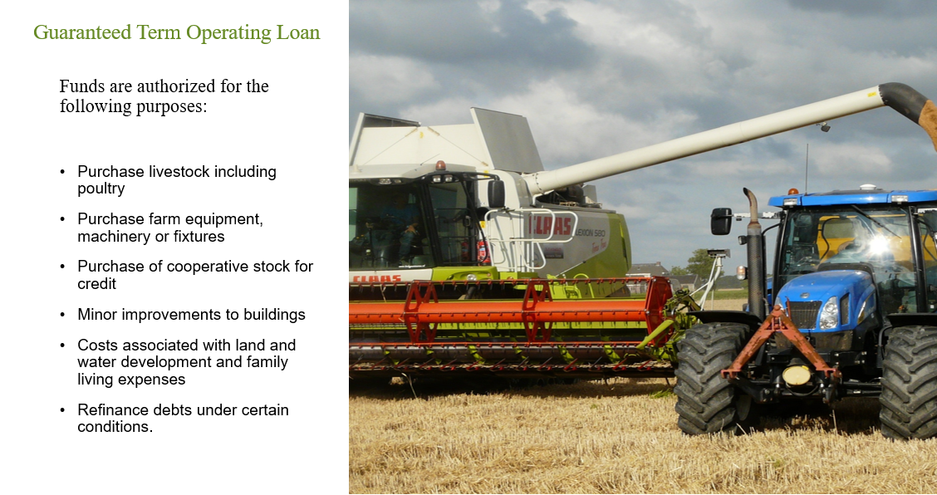

Slide 18
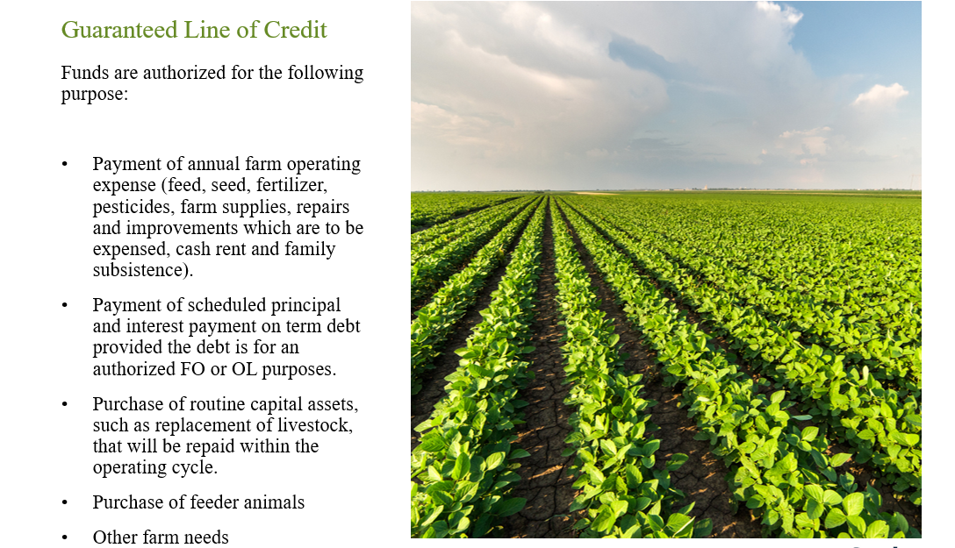

Slide 19
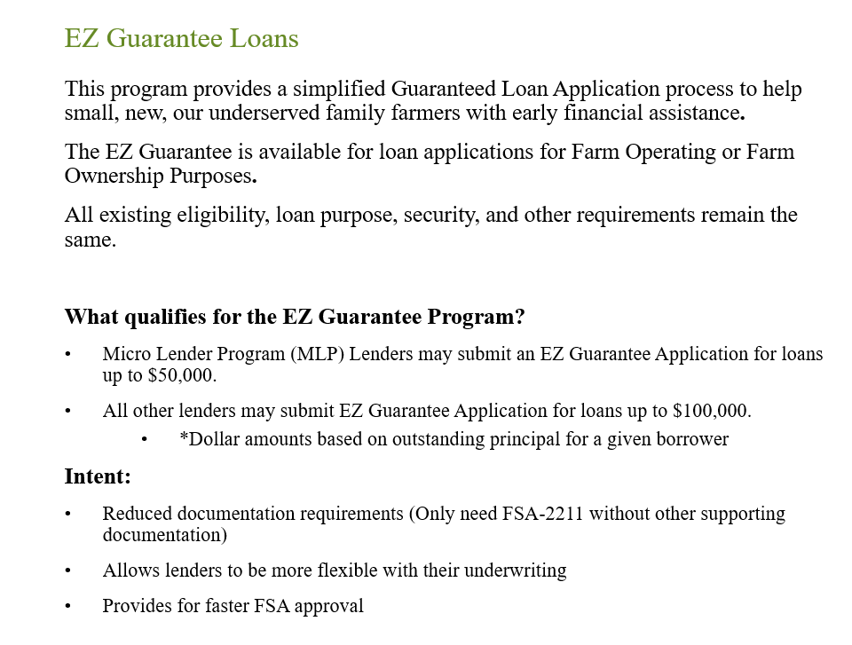

Slide 20
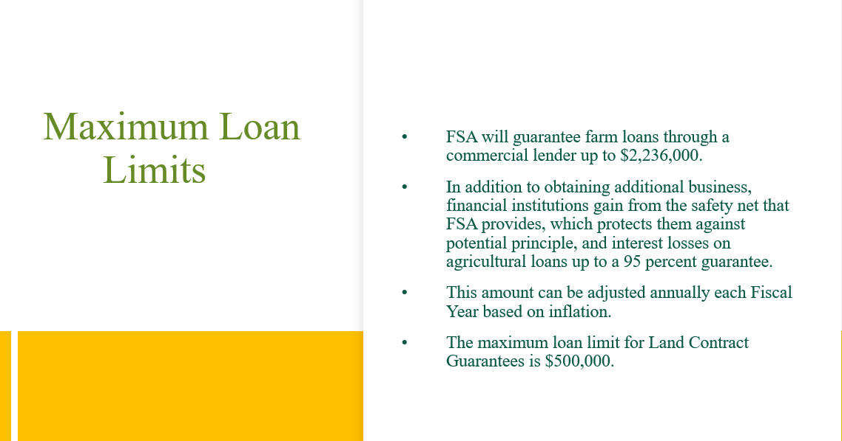

Slide 21
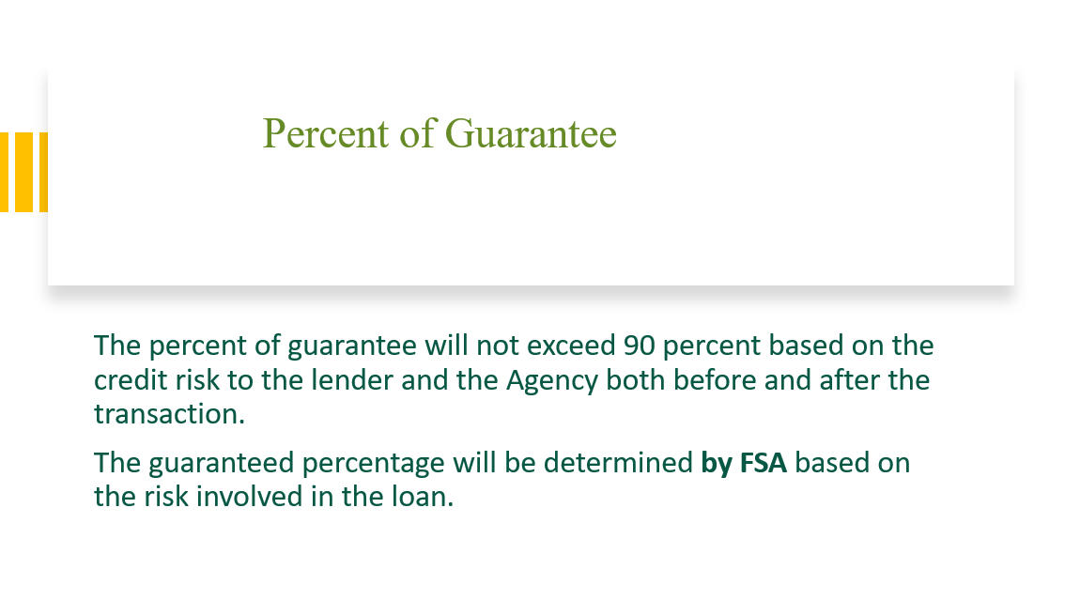

Slide 22
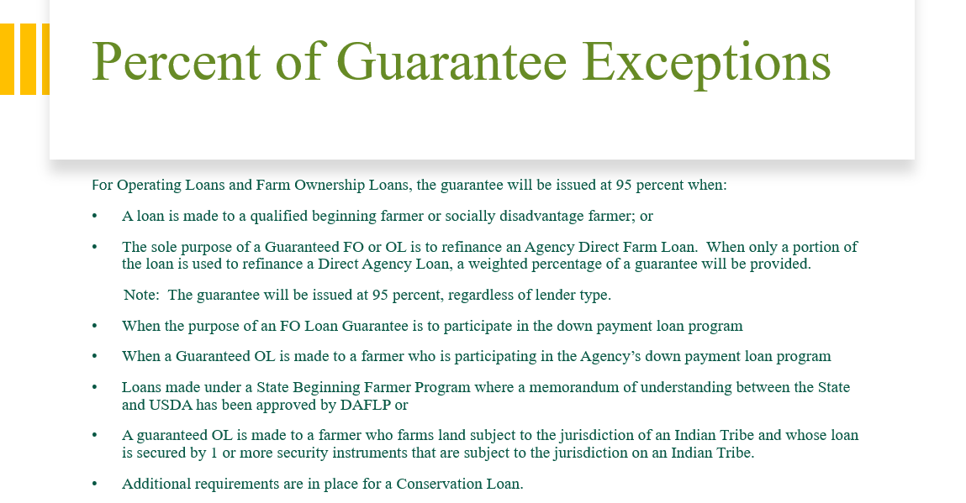

Slide 23
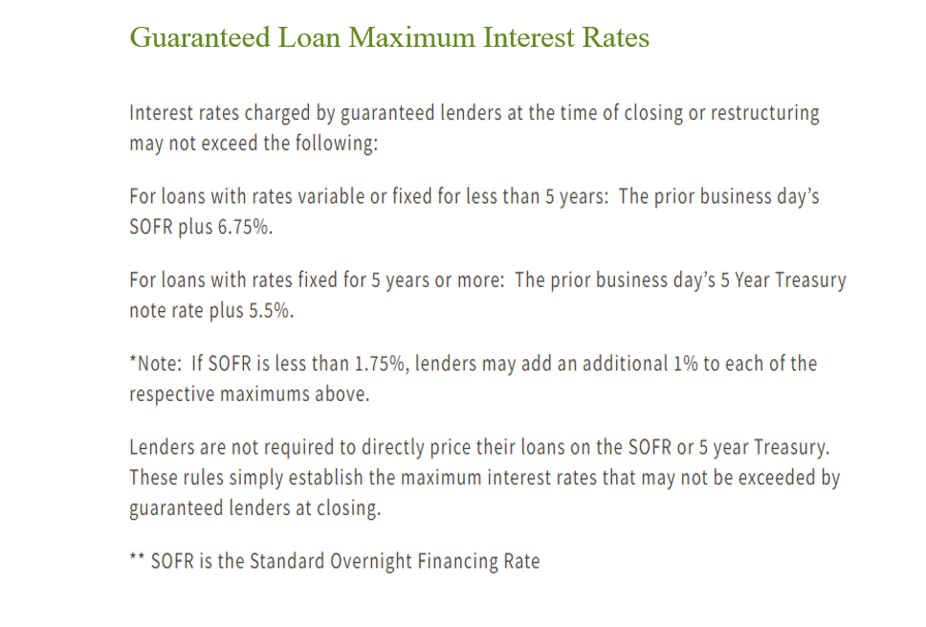

Slide 24
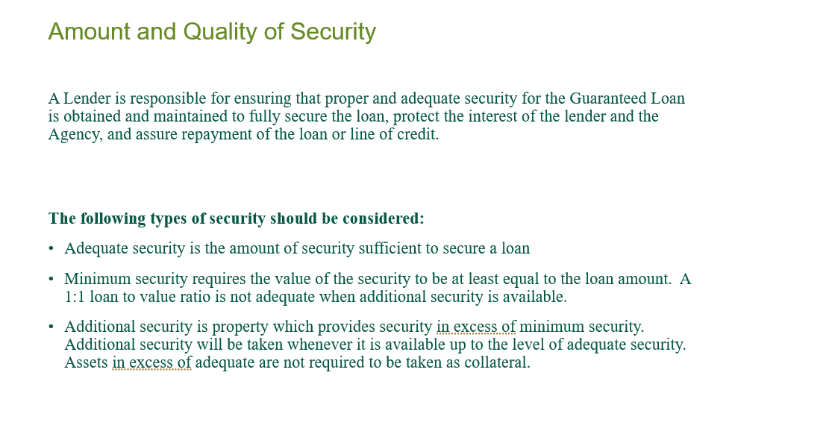

Slide 25
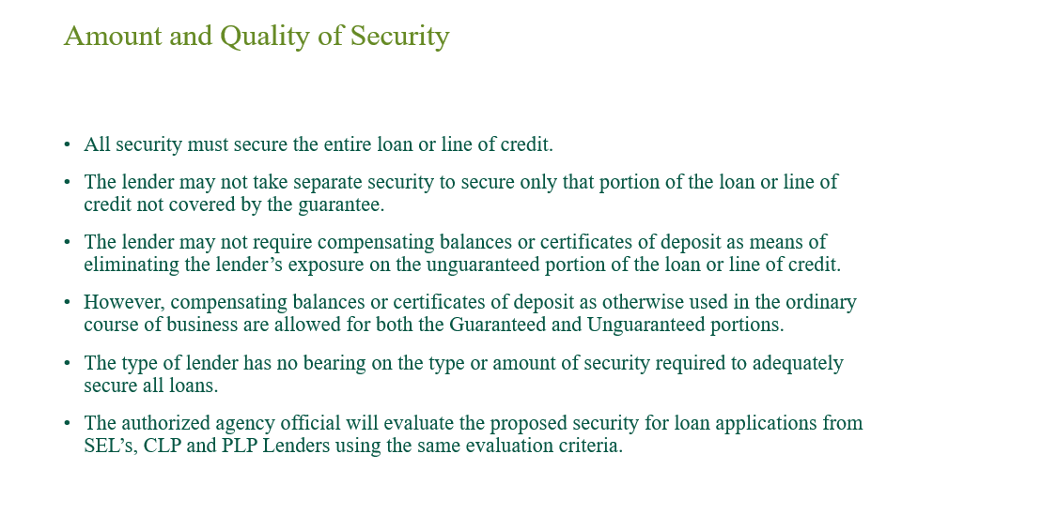

Slide 26
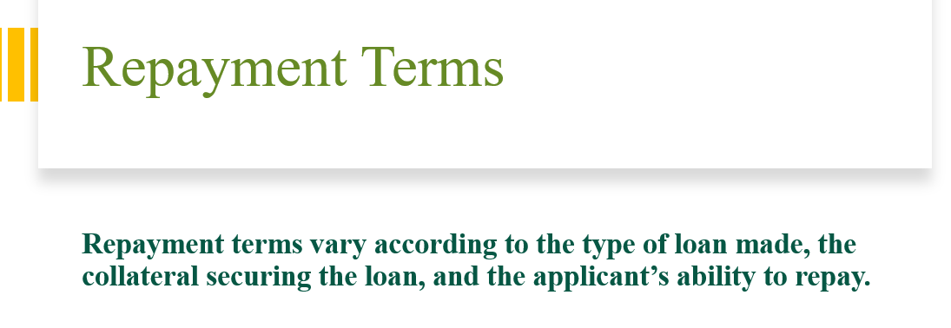

Slide 27
Repayment Terms
Term Operating Loans are normally repaid within 7 years
Farm Ownership Loans cannot exceed 40 years
Operating Lines of Credit may be advanced for up to 5 years and all advances must be repaid within 7 years of the date of the loan guarantee.

Slide 28
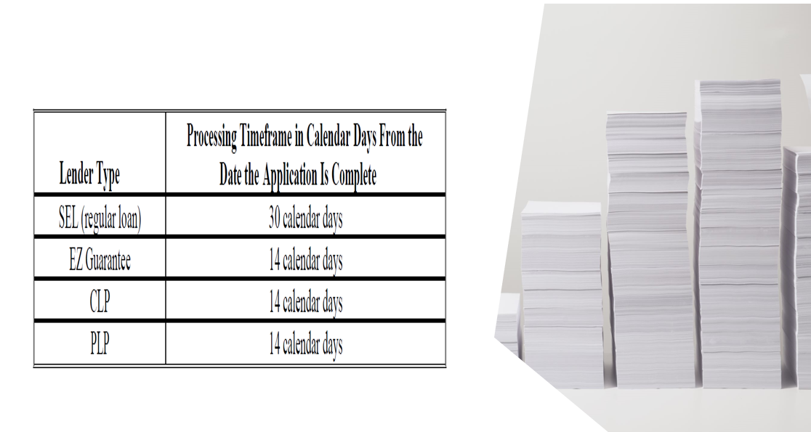
Summary of Processing times

Slide 29

Guaranteed Loan Application Packages

Slide 30
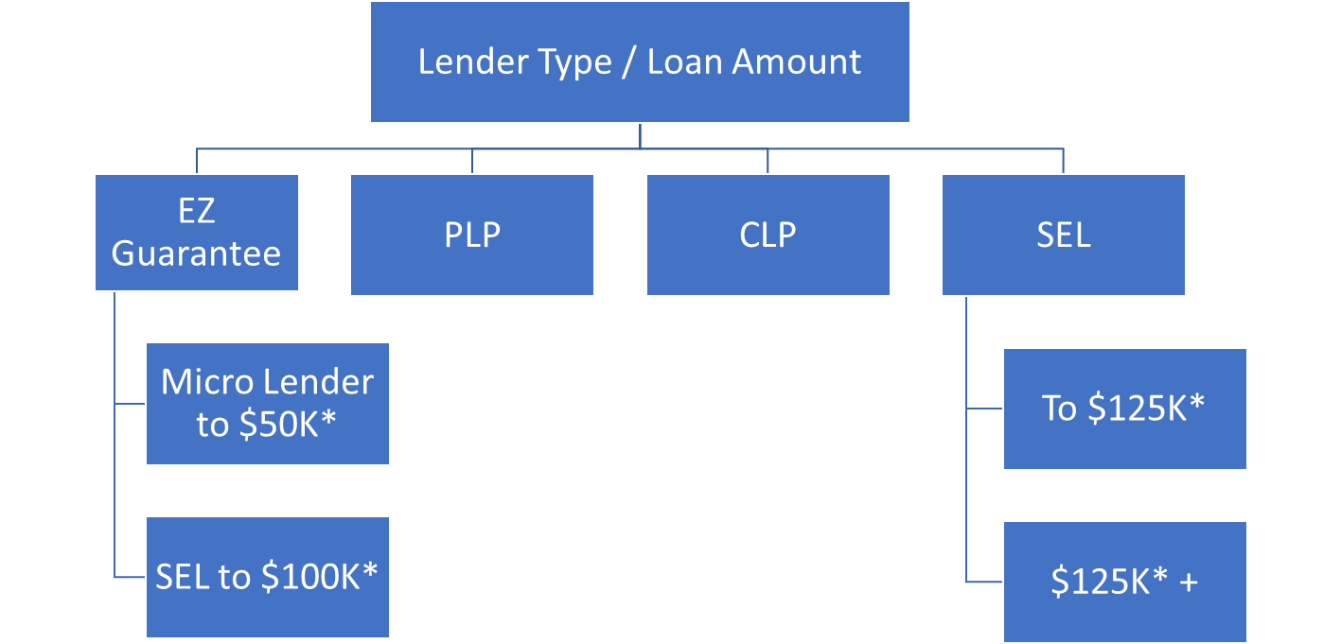
Applications
*EZ Dollar amounts based on outstanding principal. SEL dollar amounts based on transaction amount.

Slide 31
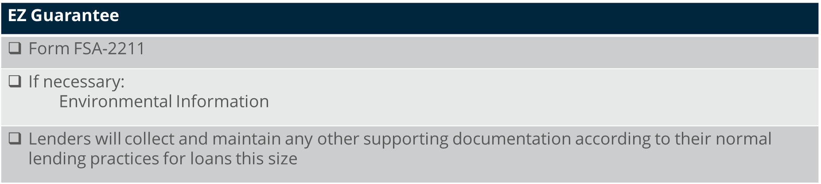

Slide 32
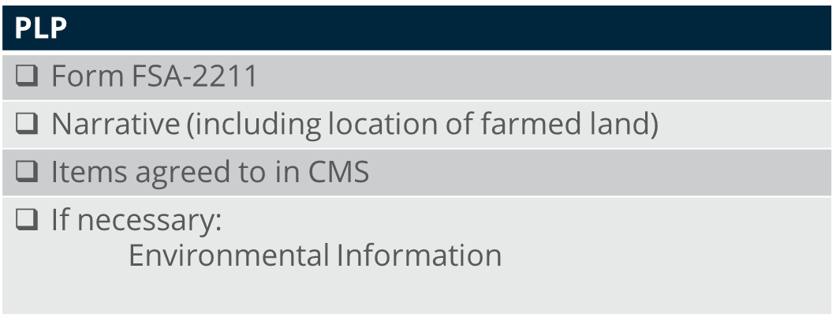

Slide 33
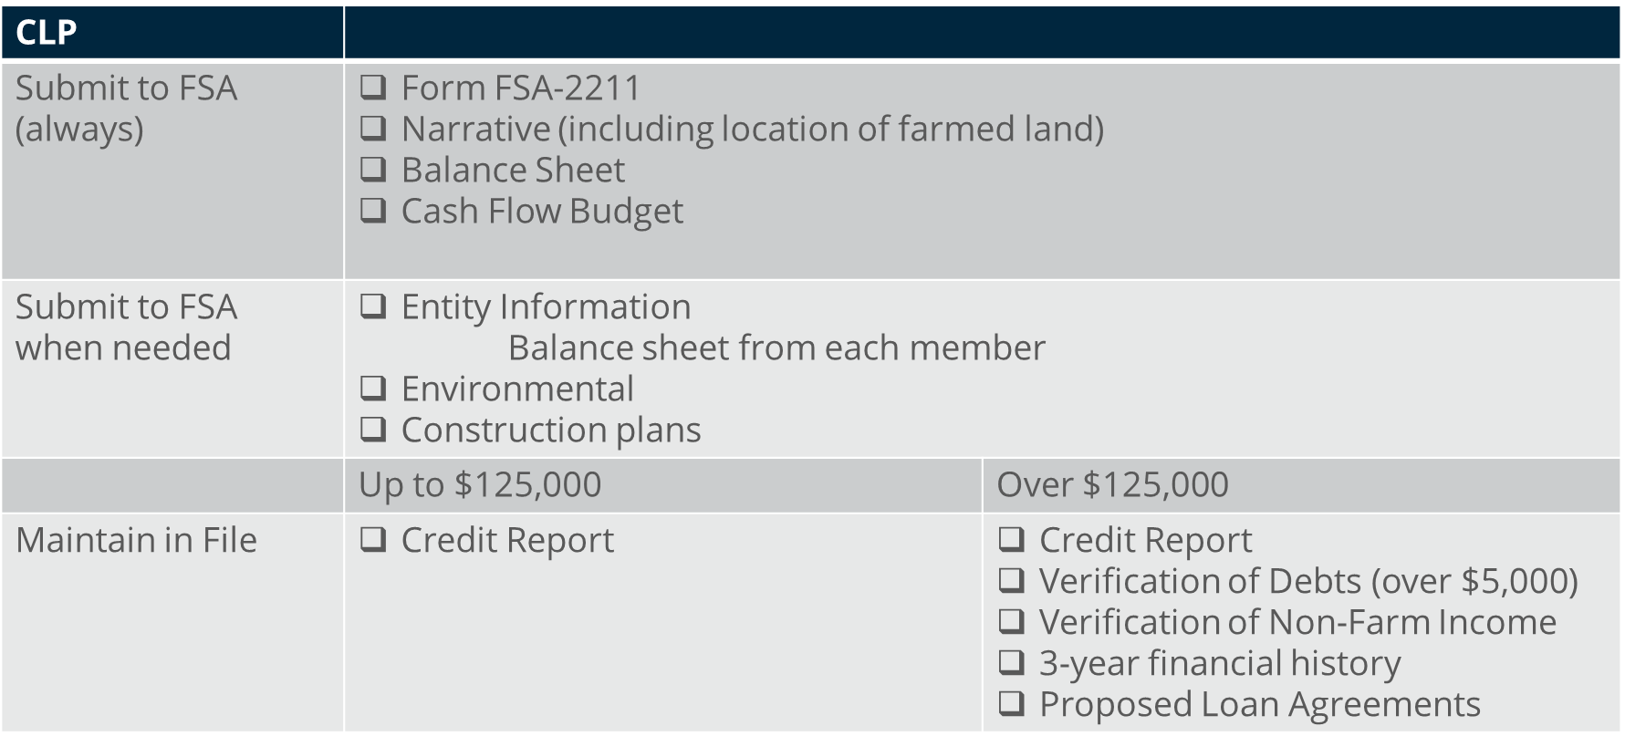

Slide 34
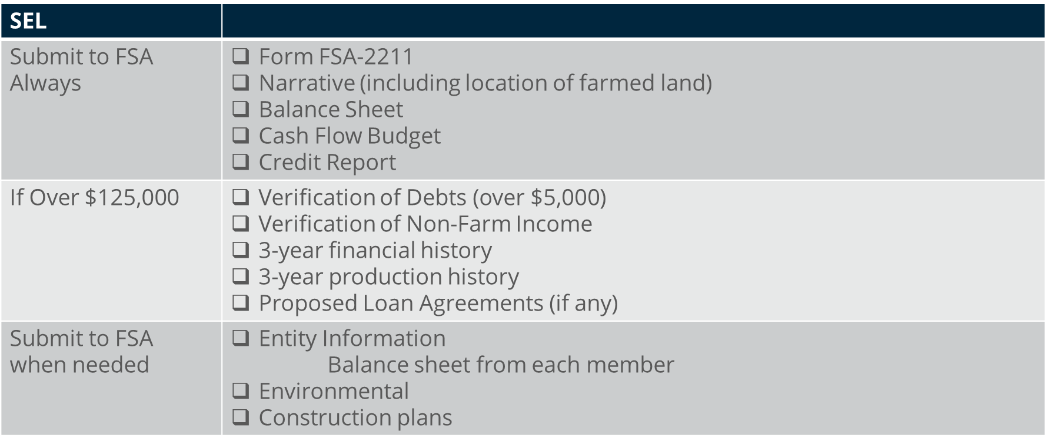

Slide 35
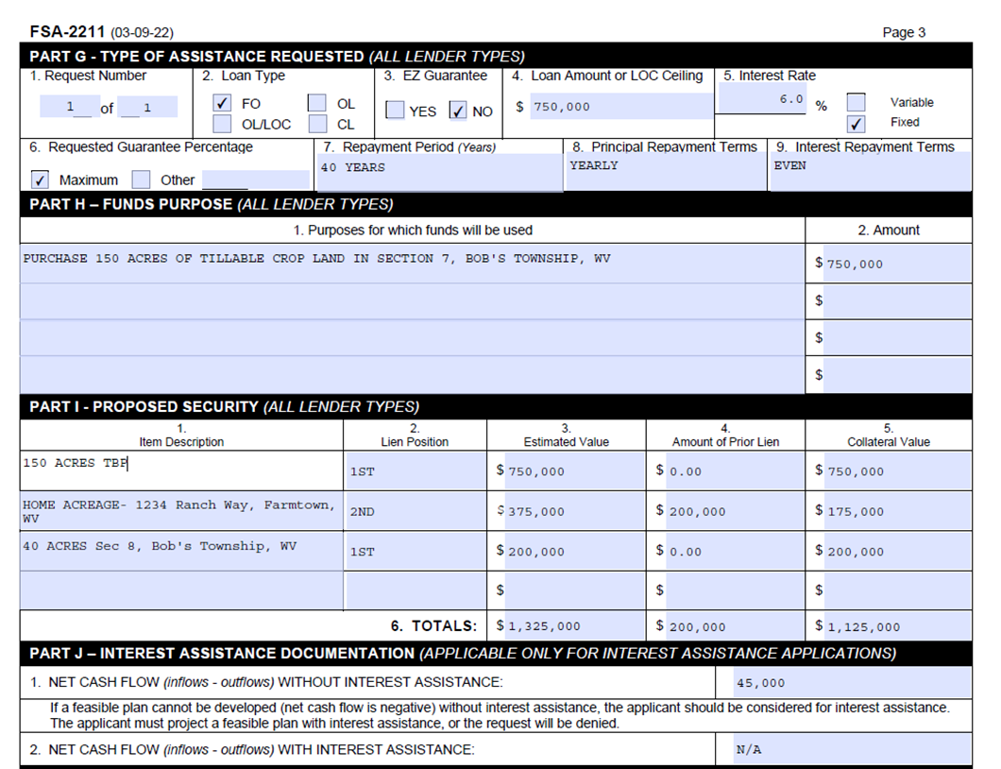
FSA-2211

Slide 36
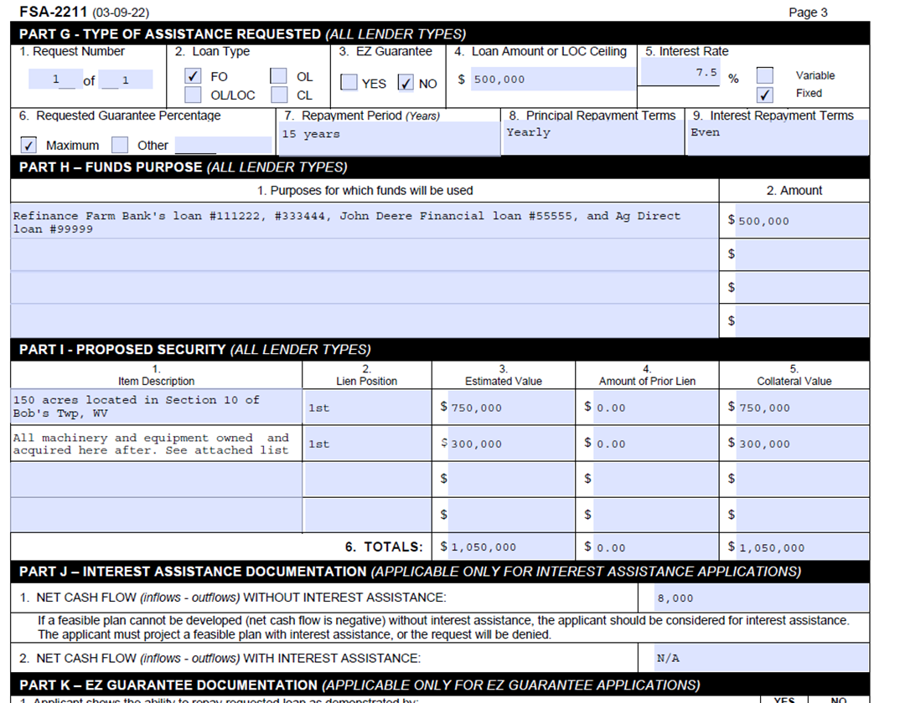
FSA-2211 Refinance

Slide 37
Signatures
2-FLP, Par. 3
What types of signatures are acceptable on forms from guaranteed lenders and applicants?
Hard copy form
Scanned / faxed copy of a handwritten signature
Emailed form with digital signature
Form submitted through USDA online services (eForms)

Slide 38

Guaranteed Loan Application Process

Slide 39
Most effective way to ensure timely application processing:
COMPREHENSIVE LOAN NARRATIVE
*Refer to Exhibit 4.5 in 2-FLP for a guide on how to construct a loan narrative and review a sample guaranteed loan narrative

Slide 40
Why a comprehensive narrative is so important -
Reduces requests for additional information from FSA staff
Only source of background information FSA has on the applicant
Covers FSA eligibility beyond the checklist questions

Slide 41
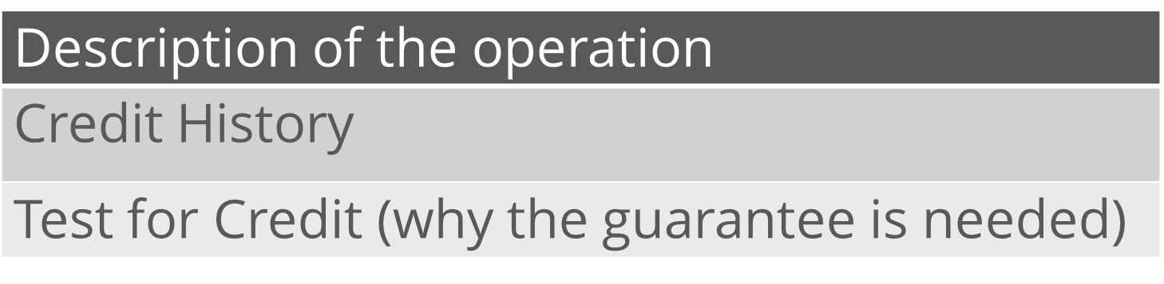
Three Most Important Items to Include:

Slide 42
Description of the Operation:
Questions to be answered in the narrative:
  Are they the operator?
    Who is the legal operator?
    Who is the physical operator?
  Is the operation a farm?
    What commodities or products do the applicant’s produce?
    Is the commodity an agricultural product?
  Is the operation family size?
    How much labor is provided by family members? Number of owner families involved
    Size (quantity, dollars) compared to typical family farm for the area
    Production quantity (Acres farmed, head raised/sold)
    Any special factors (Growth plans, past size vs. current)

Slide 43
Credit History
Don’t be silent on credit history
If negative - discuss late payments, low scores
  How these were beyond borrower’s control
  Why this is no longer a concern
What about positive? (if there are no late payments, etc.)
  If positive, can be brief - just note saying “credit history is strong with no history of late payments, and a credit score of …”

Slide 44
Test for Credit (Why do you need the guarantee)
Must be based on some weakness: cash flow, new enterprise, irregular performance history, rapid expansion, poor market, net worth, current capital position, limited collateral, new operator
Consider other assets, including personal assets
Selling on secondary market alone is not adequate. How do secondary market rates and terms necessary for operation’s success? Need to show benefit to borrower.

Slide 45
Other items to be addressed in the narrative:
Location of land farmed
Loan proposal
Any other eligibility issues
5 C’s of Credit
Capital Analysis
Capacity Analysis
Character Analysis
Collateral Analysis
Loan Conditions and Servicing Plan

Slide 46
How does FSA evaluate Guaranteed Loan Requests?
Utilize Lender’s Financial Information
-Are Cashflows realistic and based on history?
-Has the debt/income been verified
-Family living
-Proposed repayment plan
- Refinancing- one time issue or underlying issues
Lender Narrative Review
- Significant Deviations in the plan/Changes to the operation
- 5 C’s of credit and eligibility
Collateral
- Adequate and identifiable
-Additional Collateral
Conditions
-Interest Rate, term and fees meet FSA Requirements

Slide 47
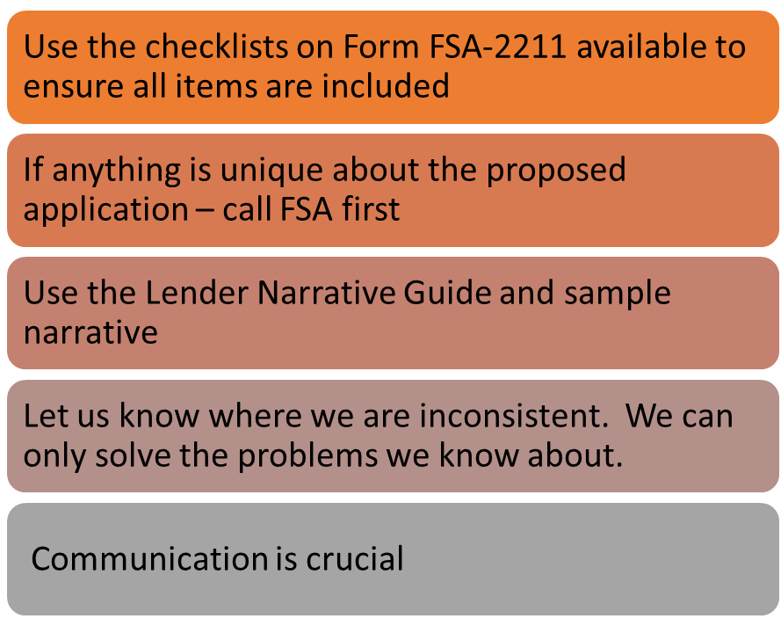
Lender Best Practices

Slide 48
FSA-2232 Conditional Commitment
Agency’s commitment to the lender that the loan is approved subject to conditions and requirements
Will only be issued when the funds have been obligated
Contains important information on:
  Loan Purposes and fee
  Interest rate and terms
  Security for the loan
  Conditions to be met before closing
IMPORTANT: Lenders cannot close a guaranteed loan or begin ground disturbance prior to receiving this document

Slide 49
Closing Requirements
Lender accepts the conditions on the FSA-2232 and returns to FSA
Lender closes the loan and submits the following to FSA
  FSA- 2236 “Guaranteed Loan Closing Report and Lender Certification”
  Guarantee Fee: Loan Amount x % guaranteed x 1.5%
    Example: $100,000 x 90% x 1.5% = $1,350
  A copy of the executed promissory note or loan agreement
FSA reviews the closing documents and executes the FSA-2235 “Loan Guarantee”

Slide 50
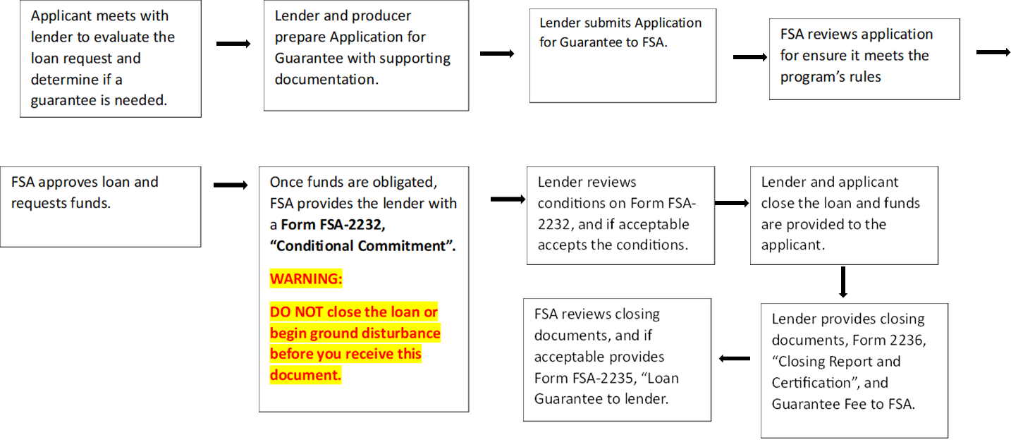
Application Process

Slide 51
What comes next:
Routine Servicing
  FSA- 2241 Guaranteed Farm Loan Status Reports (semi-annual)
  FSA-2248 Guaranteed Farm Loan Default Status Report
  Perform annual analysis of borrower’s financial condition
  Concurrence to advance on subsequent year line of credit
  Concurrence for debt acquired outside the guarantee

Slide 52
Ongoing Training Ideas:
Environmental Training
Guaranteed Servicing Responsibilities/Loss Claims
FSA Modernization Efforts
What would you recommend?
  Heather.laubenthal@usda.gov

Slide 53
Lender Resources
Lender Toolkit
https://www.fsa.usda.gov/programs-and-services/farm-loan-programs/guaranteed-farm-loans/guaranteed-loans-lender-toolkit/index
Public Forms
https://forms.sc.egov.usda.gov/eForms/searchAction.do?pageAction=BrowseForms&_MenuAction=Yes

Slide 54
Questions?
All Q&As will be posted on the lender toolkit website at a later date.

