Slide 1
FINANCIAL INQUIRIES

Slide 2
Background
Financial Inquiries (FI) allows producers and their authorized representatives* to view:
6 years of data for payments, collections and IRS form data
all years for debt
* Your local Service Center can help you establish representatives via the Representative Link Management System (RLMS).

Slide 3
Financial Inquiries URL
Select the following link for the FI application:
https://apps.fsa.usda.gov/financial-inquiries/

Slide 4
How Do Producers or Representatives Obtain Access to FI
The following is information on access to FI Level 2 eAuth for producers and representatives.
Level 2 eAuth Access
All producers and/or representatives must obtain Level 2 eAuth access.
Currently, eAuth is only available to individuals. A business or entity cannot register for Level 2 eAuth access.
The producer or representative can elect either of the following options to complete identity verification:

Slide 5
1. Online Self-Service Identity Verification
2 . In-Person Identity Verification Through a Service Center Local Registration Authority (LRA)
The user may visit their local Service Center to establish Level 2 eAuth.
Visit: https://identitymanager.eems.usda.gov/registration/index.aspx.
CLICK “Register for a Level 2 Account”.
Once the user applies for level 2 access, an e-mail will be sent explaining both the online self-service identify verification and in-person identify verification options. The e-mail will contain a link to the online identify verification process.
This verification process relies on United States credit history. If adequate history is not available, the producer or representative will receive a message indicating they must go to an office to complete the process.
When Level 2 eAuth is complete, the producer’s or representative’s local Service Center must link the eAuth ID to the producer’s or representative’s account.

Slide 6
Producer and Representative Assistance
Producers or representatives needing assistance should use either of the following methods:
contact the eAuth Help Desk at 1-800-457-3642, choose Option 1
visit the local Service Center LRA for assistance.

Slide 7
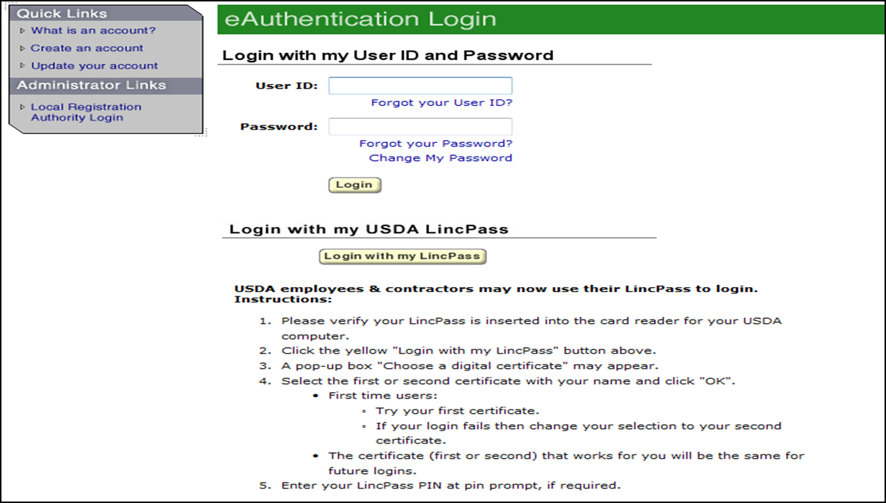

Logging In to Financial Inquiries
Producers and Representatives may log in using their level 2-eAuth user ID and password.

Slide 8
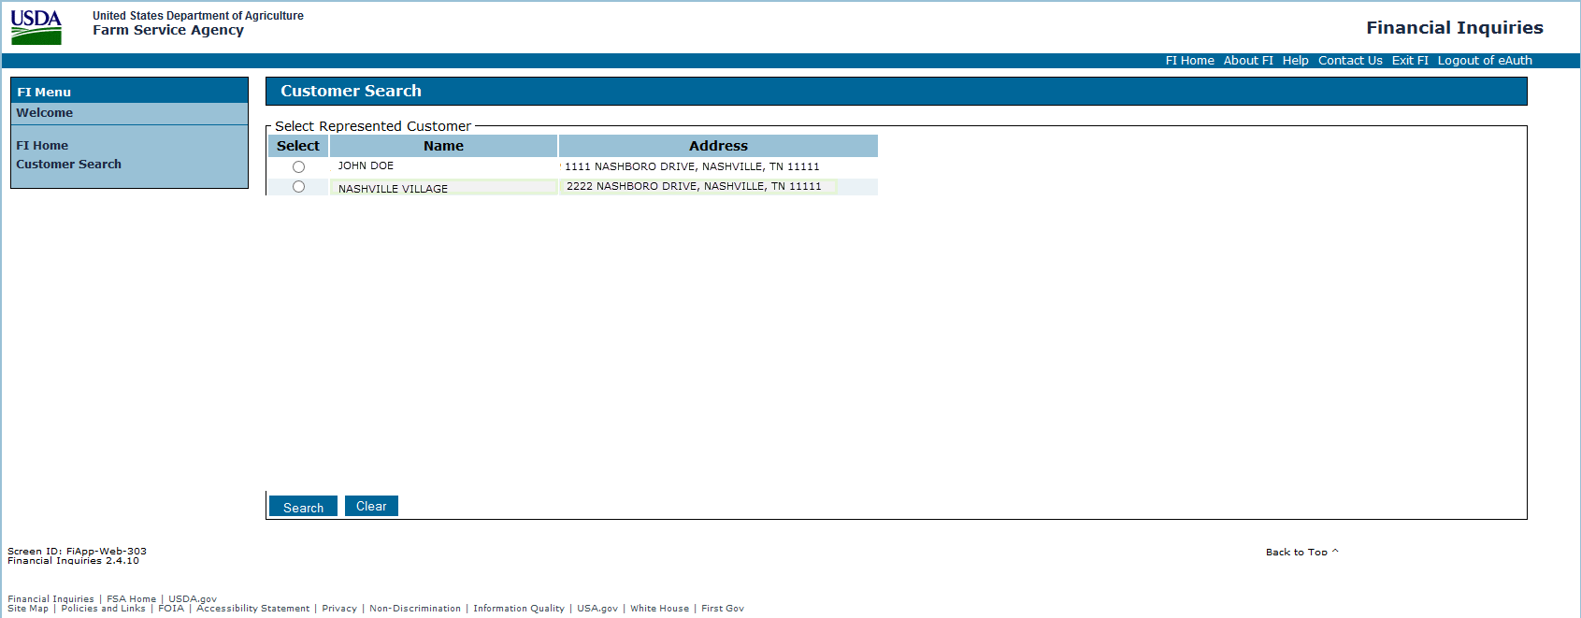
Selecting Producer
If you represent two or more producers, you will see a ‘Customer Search’ screen.
Select the producer you wish to view.
Select “Submit”

Slide 9
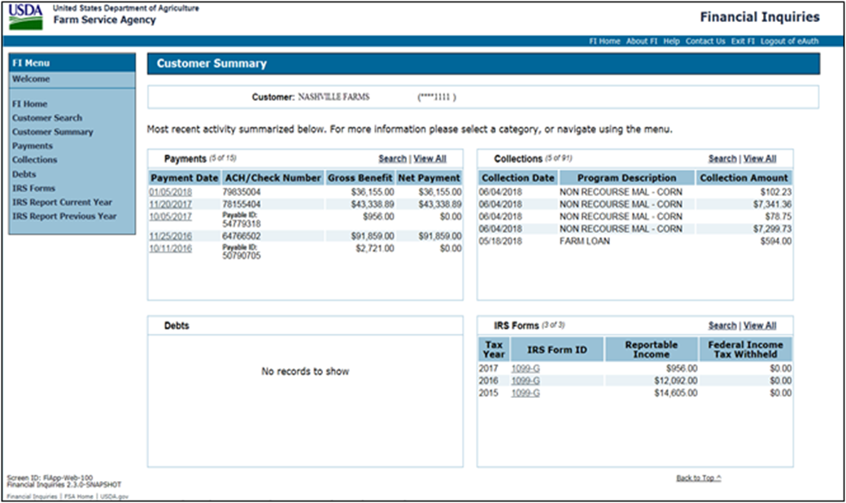
Customer Summary
The following is an example of the Customer Summary Screen.

Slide 10

Customer Summary (Continued)
The Customer Summary Screen displays the 5 most recent transactions for each of the following financial activities for the producer, if applicable:
“Payments” displays summary information on program payments
“Collections” displays collections received from the producer or on the producer’s behalf, including which program the collection was for and the amount of the collection
“Debts” displays the NRRS receivable ID, program, and outstanding principal for receivables and claims owed to FSA/CCC by the producer
“IRS Forms” displays a summary of amounts reported to IRS.
The user may select displayed records to view more details.
Each financial activity section on the Customer Summary Screen will display a link for user to “Search” for a specific item or range of items or “View All” records.
All FI screens are read-only.

Slide 11
Financial Inquiries Standard Links
The following links are standard throughout FI Menu on the left side of the screen to assist users with common functions.
Note: Unless you are a representative with access to multiple producer accounts, you will not have the ‘Customer Search’ option.
Link | Functions
Customer Search | Allows user to search to look up a customer.
Customer Summary | Allows users to view customer’s five most recent: Payments Collections Debts IRS Form Data
Payments | Allows users to enter selection criteria for payment search
Collections | Allows users to enter selection criteria for collection search
Debts | Allows users to enter selection criteria for debt search
IRS Forms | Allows users to enter selection criteria for IRS Form Type search
IRS Report Current Year | Allows users to view IRS reportable information for the current year
IRS Report Previous Year | Allows users to view IRS reportable information for the previous year.

Slide 12
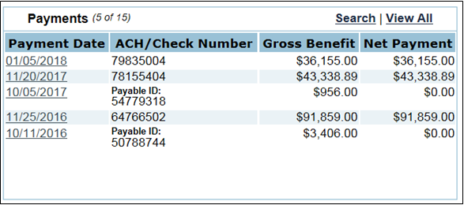

The following is an example of the Payment Section.
Payment Section
CCC Debt offsets, Tax Withholdings and other deductions may cause the Gross Benefit to be more than the Net Payment.

Slide 13
Payment Section(Continued)
The following table describes the Payment Section Screen fields.
Field | Description
Number of payment records displayed of the number available (X of X)
Payment Date | Date payment was issued
ACH/Check Number | ACH: Automated Clearing House (ACH) number which is assigned to trace the disbursement through the financial institution processing from the Federal Reserve Bank to its final account deposit. Check: Payment identification number which is either the check number, or for payments fully offset, the Payable ID will be displayed
Gross Benefits | Amount earned from the program payment
Net Payment | Amount disbursed after deductions
Search | Link to allow users to select criteria for payment search
View All | Link to view all records

Slide 14
Payment Detail
From the Payments section, CLICK the applicable date under the “Payment Date” column. The “Payment Detail” Screen will be displayed.

Slide 15
Payment Detail (Continued)
The following table describes the Payment Detail Screen fields.
Field | Description
Customer | Individual who earned the program payment
Last 4 digits of TIN | TIN of individual who earned program payment
Information as of (mm/dd/yyyy) | Date information was last updated in FI
Payee Name | Individual who received program payment (may be the producer, an assignee, other agency, or alternate payee)
Payment Date | Date payment was issued
Total Payment Amount | Net payment amount disbursed
State | State responsible for issuing the payment
County | Service Center responsible for issuing payment
Check Number | check number issued by Treasury, if payment was fully offset no check or ACH information will be displayed
Payable ID | System-generated internal identifying number (NPS Payable ID)
Program | Program description in which the payment was earned
Reference Number | Reference type and number assigned by the program application
Program/Crop Year | Crop year, program year, calendar year or budget year, if applicable.
Gross Benefits | Amount earned from the program
Deductions | Amount subtracted from gross benefit amount
Net Payment | Amount remaining after deductions and other payments, such as Assignments or Debt Offsets

Slide 16
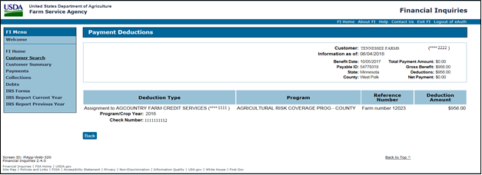

Payment Deductions
The following is an example of the “Payment Deductions Screen” with an “Assignment” deduction type.
Deduction types include the following:
Assignment
Foreign Person Tax Withholding
FSA/CCC Debt Repayment
Involuntary Tax Withholding
Voluntary Tax Withholding
The deduction type will display details about the recipient of the funds deducted from the payment and the check or ACH information, if applicable.

Slide 17
Payment Search Screen
From the Payments Section of the Customer Summary Screen, CLICK “Search”. The Payments Search Screen will be displayed.

Slide 18
Payment Search Screen (Continued)
Select or enter the following search criteria as needed. Selecting “Search” without specifying criteria will return all available payments.
Field | Description
Customer | Individual who earned the payment
Last 4 digits of TIN | TIN of individual who earned the payment
Information as of (mm/dd/yyyy) | Date information was last updated in FI
Payment Date Range (mm/dd/yyyy) | Beginning and ending issue dates
Program | Select the applicable program(s) from the dropdown box.
Gross Benefit Amount Range | Enter the minimum and maximum dollar amount of the benefit. If a payment was offset for debt, assignments, etc., the amount received will be less than the benefit.
State | State in which payment was issued
County | Service Center in which payment was issued
ACH/Check Number | ACH or Treasury check number.
Click:
“Search” to process the selection and display “Program Benefits” screen
“Clear” to remove all information entered in the fields
Search Screens may also be accessed under the FI Menu on the left for: Payments, Collections, Debts, and IRS Forms.

Slide 19
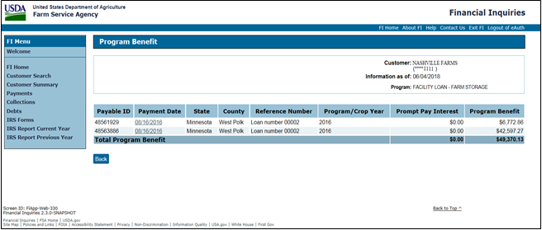

Program Benefit Screen
From the Payment Search Screen, CLICK “Search” to process the selection and display the Program Benefit Screen with the search results.
The Program Benefit Screen will only be displayed if “Program” is selected as search criteria.

Slide 20
Program Benefit Screen (Continued)
The following table describes the Program Benefit Screen fields.
Field | Description
Customer | Individual who earned the program payment
Last 4 digits of TIN | TIN of individual who earned program payment
Information as of (mm/dd/yyyy) | Date information was last updated in FI
Program | Search criteria that is selected, will be displayed, if applicable Example: “Program: Facility Loan-Farm Storage”
Payable ID | System-generated internal identifying number (NPS Payable ID)
Payment Date | Date payment was issued
State | State responsible for issuing the payment
County | Service Center responsible for issuing payment
Reference Number | Contract Number, Farm Number (depending on the program)
Program/Crop Year | Crop year, program year, calendar year or budget year, if applicable
Prompt Pay Interest | Amount of prompt pay interest paid, if applicable
Program Benefit | Amount earned from the program payment
Totals | Prompt Pay Interest Program Benefit
Selecting a date from the “Payment Date” column will take the user to the Payment Detail Screen to view details about the disbursement.

Slide 21
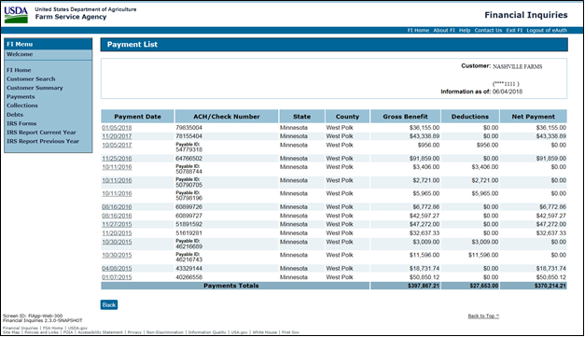
From the Payments Section of the Customer Summary Screen, CLICK
“View All”. The Payment List Screen will be displayed.
Payment List Screen

Slide 22
The following table describes the Payment List Screen fields.
Payment List Screen (Continued)
Field | Description
Customer | Individual who earned the program payment
Last 4 digits of TIN | TIN of individual who earned program payment
Information as of (mm/dd/yyyy) | Date information was last updated in FI
Payment Date | Date payment was issued
ACH/Check Number | check number issued by Treasury, if payment is a Direct Deposit, the label will indicate ACH Number, Trace Number, Bank Name and Account Number for the payment if payment was fully offset, the NPS Payable ID will display
State | State responsible for issuing the payment
County | Service Center responsible for issuing payment
Gross Benefit | Amount earned from the program payment
Deductions | Amount subtracted from gross payment amount
Net Payment | Amount remaining after deductions
Payment Totals | Gross Benefits Deductions Net Payment
Selecting a date from the “Payment Date” field will take the user to the Payment Detail Screen.

Slide 23
Collection Section
The following is an example of the Collections Section of the Customer Summary Screen.
The following table describes the Collection Section fields.
Field | Description
Number of collection records displayed of the number available (X of X)
Collection Date | Date collection was recorded
Program Description | Program in which collection was recorded
Collection Amount | Amount collected
Search | Link to allow users to select criteria for collection search
View All | Link to view all records

Slide 24
Collection Search Screen
From the Collections Section, CLICK “Search”. The Collections Search Screen will be displayed.

Slide 25
Select or enter the following search criteria as needed. Selecting “Search” without specifying criteria will return all available collections.
Collection Search Screen (Continued)
Field | Description
Customer | Individual responsible for debt in which collection was made
Last 4 digits of TIN | TIN of individual responsible for debt in which collection was made
Information as of (mm/dd/yyyy) | Date information was last updated in FI
Collection Date Range (mm/dd/yyyy) | Enter the beginning and ending collection date
Program | Select the program(s) from the dropdown box (only programs applicable to this customer will be displayed)
Collection Amount Range (Min/Max dollar amount) | Enter the minimum and maximum dollar amount of collection
Click:
“Search” to process the selection and display “Collection Details” screen
“Clear” to remove all information entered in the fields.
Clicking “Search” without specifying criteria will return all available collections.

Slide 26
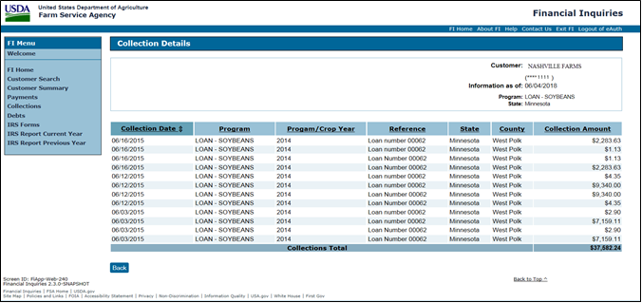
Collection Details Screen
Once “Search” is clicked on the Collections Search Screen, the Collection Details Screen will be displayed with search results.
If multiple records are displayed, sorting search results are available in either ascending or descending order by clicking the column heading.

Slide 27

Collections Details Screen (Continued)
The following table describes the Collection Details Screen fields.
Field | Description
Customer | Individual responsible for debt in which collection was made
Last 4 digits of TIN | TIN of individual responsible for debt in which collection was made
Information as of (mm/dd/yyyy) | Date information was last updated in FI
Program/State | Search criteria that is selected, will be displayed, if applicable Example: “Program: Loan-Soybeans, State-Minnesota”
Collection Date | Date collection was recorded
Program | Program description in which collection was received
Program/Crop Year | Crop year, program year, calendar year or budget year, if applicable
Reference | Contract Number, Farm Number (depending on the program)
State | State responsible for collection
County | Service Center responsible for collection
Collection Amount | Amount of collections
Collections Total | Total amount of collection.
Click “Back” to return to the Collections Search Screen.
If no search criteria are needed, Click “View All” from the Collections Section of the Customer Summary Screen.

Slide 28
Debt Section
The following is in example of the Debts Section of the Customer Summary Screen.

Slide 29
The following table describes the Debts Section fields.
Debt Section (Continued)
Field | Description
Number of debt records displayed of the number available (X of X)
Receivable ID | Unique number assigned to producer’s debt by FSA’s National Receipt and Receivable System
Program Description | Program in which debt originated
Outstanding Balance | Amount remaining on debt. NOTE: Balance does not include interest which may have accrued since the last activity occurred on this debt.
Search | Link to allow users to select criteria for debt search
View All | Link to view all records

Slide 30
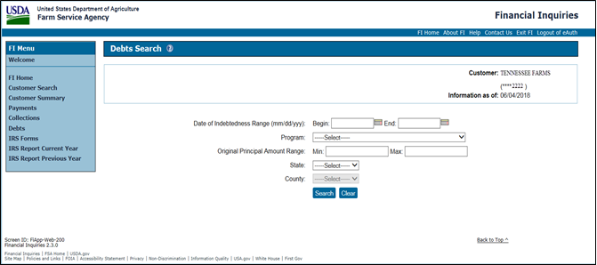
Debt Search Screen
From the Debts Section, CLICK “Search”. The Debts Search Screen will be displayed.

Slide 31
Debt Search Screen (Continued)
The following table describes the Debts Search Screen fields.
Field | Description
Customer | Individual responsible for debt
Last 4 digits of TIN | TIN of individual responsible for debt
Information as of (mm/dd/yyyy) | Date information was last updated in FI
Date of Indebtedness Range (mm/dd/yyyy) | Date the customer originally incurred the debt. This is most commonly the date of payment for a program that as later determined to be overpaid. (may sometimes be the date of the initial notification letter or the date of discovery)
Program | Program in which debt originated
Original Principal Amount Range (Min/Max dollar amount) | Original amount of principal on a debt
State | State in which the debt was incurred
County | Service Center in which the debt was incurred.
Click:
“Search” to process the selection and display “Debt List” screen
“Clear” to remove all information entered in the fields.

Slide 32
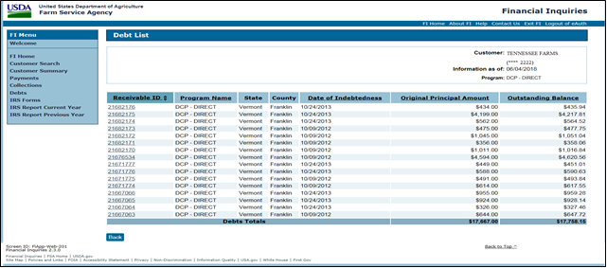
Debt List Screen
Once “Search” is selected from the Debts Search Screen, the Debt List Screen will be displayed with search results.
The user has the options to:
sort search results in either ascending or descending order by clicking the applicable column heading
select the applicable receivable ID number.

Slide 33

Debt List Screen (Continued)
The following table describes the Debt List Screen fields.
Field | Description
Customer | Individual responsible for debt
Last 4 digits of TIN | TIN of individual responsible for debt
Information as of (mm/dd/yyyy) | Date information was last updated in FI
Program | If search a criteria is selected, selections will be displayed Example: “Program: DCP-Direct”
Receivable ID | Unique number assigned to producer’s debt by FSA’s National Receipts and Receivables System
Program Name | Program in which the debt originated
State | State in which the debt was made
County | Service Center in which the debt was made
Date of Indebtedness Range (mm/dd/yyyy) | Date the customer originally incurred the debt. This is most commonly the date of payment for a program that as later determined to be overpaid. (may sometimes be the date of the initial notification letter or the date of discovery)
Original Principal Amount | Original amount of principal on debt
Outstanding Balance | Amount remaining on debt. NOTE: Balance does not include interest which may have accrued since the last activity occurred on this debt.
Debt Totals | Original Principal Amount Outstanding Balance
Click “Back” to return to the Debts Search.
If no search criteria is needed, CLICK “View All” from the Debts Section of the Customer Summary Screen.

Slide 34
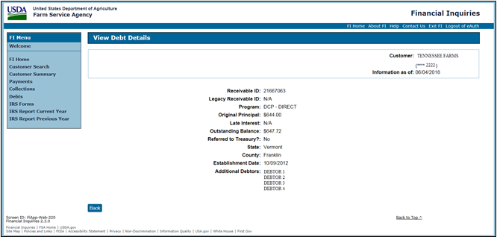
View Debt Details Screen
From the Debt List Screen, under the “Receivable ID” column, select the applicable receivable ID number. The View Debt Details Screen will be displayed.

Slide 35
View Debt Details Screen (Continued)
The following table describes the View Debt Details Screen fields.
Field | Description
Customer | Individual responsible for debt
Last 4 digits of TIN | TIN of individual responsible for debt
Information as of (mm/dd/yyyy) | Date information was last updated in FI
Receivable ID | Unique number assigned to producer’s debt by FSA’s National Receipts and Receivables System (NRRS)
Legacy Receivable ID | Number assigned by a legacy system to externally identify a receivable Note: Only Debt incurred prior to September 11, 2009, will have a legacy receivable ID.
Program | Program in which the debt originated
Original Principal | Original amount of principal on debt
Late Interest | The rate of interest applied when the first demand letter is issued.
Outstanding Balance | Amount remaining on debt. NOTE: Balance does not include interest which may have accrued since the last activity occurred on this debt.
Referred to Treasury? | Indicator that identifies whether a debt has been referred to Treasury for collection
State | State in which the debt was made
County | Service Center in which the debt was made
Established Date | The date the Receivable is established in the System (NRRS)
Additional Debtors | Identifies all individuals, entities or businesses associated with debt.
Click “Back” to return to the Debt List Screen.

Slide 36
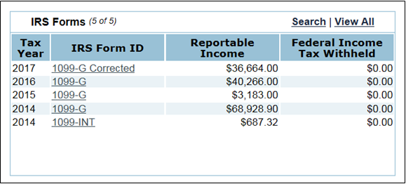
IRS Form Data
The following is an example of the IRS Forms Section of the Customer
Summary Screen.
The following table describes the IRS Forms Section fields.
Field | Description
Number of IRS Form records displayed of the number available (X of X)
Tax Year | Calendar year in which taxable income was received and IRS Form was issued
IRS Form ID | Type of form submitted to the IRS
Reportable Income | Amount reportable to the IRS
Federal Income Tax Withheld | Amount withheld from payments and submitted to the IRS on the recipient’s behalf
Search | Link to allow users to select criteria for IRS Form search
View All | Link to view all records.

Slide 37
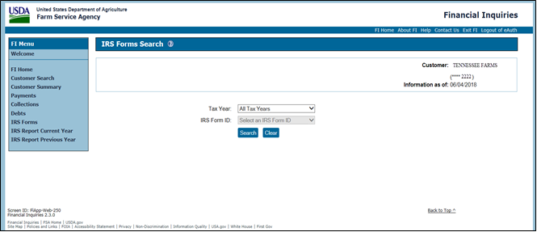

IRS Forms Search Screen
From the IRS Forms Section, Click “Search”. The IRS Forms Search
Screen will be displayed.
If “All Tax Years” is selected, the “IRS Form ID”
drop-down box will be disabled.
Selecting “Search” without specifying criteria will return all available IRS forms.
Select the following search criteria as needed:
“Tax Year” to select “All Tax Years” or a single tax year from the drop-down box
“IRS Form ID” to select the applicable IRS Form.
Click:
“Search” to process the selection and the IRS Form List Screen will be displayed
“Clear” to remove all information entered in the fields.

Slide 38
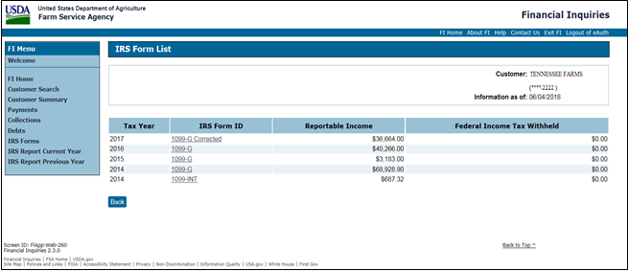
Once “Search” is selected from the IRS Forms Search Screen, the IRS Form List Screen will be displayed with search results.
IRS Form List Screen

Slide 39
IRS Form List Screen (Continued)
The following table describes the IRS Forms List Screen fields.
Field | Description
Customer | Individual who earned the program payment
Last 4 digits of TIN | TIN of individual who earned program payment
Information as of (mm/dd/yyyy) | Date information was last updated in FI
Tax Year | Calendar year in which taxable income was received and IRS Form was issued
IRS Form ID | Type of form submitted to the IRS
Reportable Income | Amount reportable to the IRS
Federal Income Tax Withheld | Amount withheld from payments and submitted to the IRS on the recipient’s behalf
From the “IRS Form ID” column, select the applicable form to display the “IRS Form Information” Screen.
Click “Back” to return to the IRS Forms Search Screen.

Slide 40
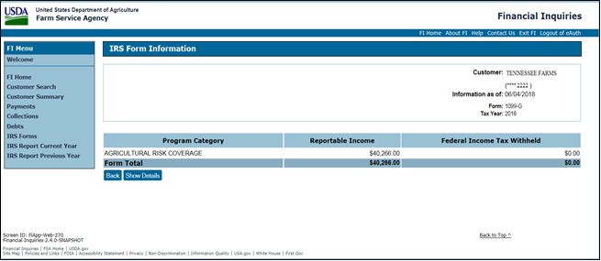
IRS Form Information Screen
The following is an example of the IRS Form Information Screen.

Slide 41
IRS Form Information Screen (Continued)
The following table describes the IRS Forms Information Screen fields.
Field | Description
Customer | Individual who earned the program payment
Last 4 digits of TIN | TIN of individual who earned program payment
Information as of (mm/dd/yyyy) | Date information was last updated in FI
Form, Tax Year | If search criteria is selected, selections will be displayed Example: “Form, Tax Year
Program Category | Name of IRS program category associated with the payment reported to the IRS
Reportable Income | Amount reportable to the IRS
Federal Income Tax Withheld | Amount withheld from payments and submitted to the IRS on the recipient’s behalf
Click:
“Back” to return to the IRS Form List Screen
“Show Details” the IRS Form Information – Detail Screen will be displayed.

Slide 42
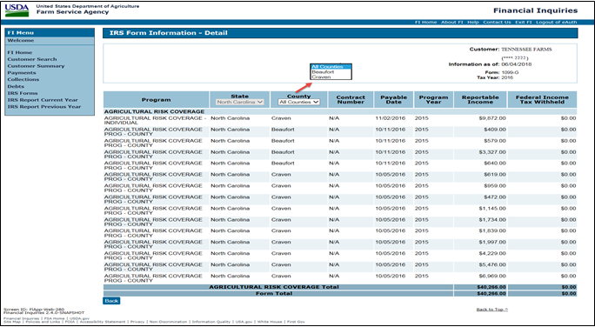
Once “Show Details” has been selected from the IRS Form Information Screen, the IRS Form Information – Detail Screen will be displayed.
IRS Form Information-Detail Screen

Slide 43
IRS Form Information-Detail Screen (Continued)
The following table describes the IRS Forms Information – Detail Screen fields.
Field | Description
Customer | Individual who earned the program payment
Last 4 digits of TIN | TIN of individual who earned program payment
Information as of (mm/dd/yyyy) | Date information was last updated in FI
Form/Tax Year | If Search Criteria is selected, selections will be displayed Example: “Form, Tax Year”
Program | Name of program category as it appears on IRS Form
State | State in which IRS reportable payment was made
County | Service Center responsible for issuing IRS reportable payment
Contract Number | reference number (depends on the program)
Payable Date | Date payment was issued
Program Year | crop year, program year, calendar year or budget year, if applicable
Reportable Income | Amount reportable to the IRS
Federal Income Tax Withheld | Amount withheld from payment and submitted to the IRS on the recipient’s behalf

Slide 44
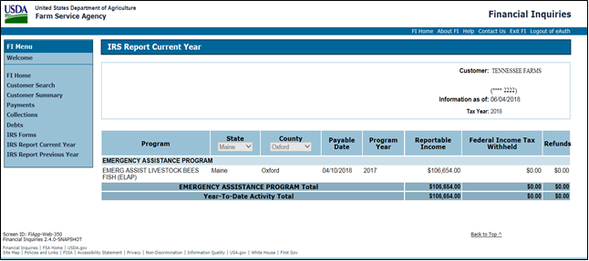

IRS Report Current Year
The IRS Report Current Year Screen will display IRS reportable payments for the current year. Click “IRS Reporting Current Year” from the FI Menu. The Current and Previous Year Reports assist in identifying which payments generated a taxable benefit to the producer versus payments offset by receivables for administrative purposes.
If user has access to multiple States and/or counties, field headers will have drop-down menus to select criteria.

Slide 45
IRS Report Current Year Screen (Continued)
The following table describes the IRS Report Current Year Screen fields.
Field | Description
Customer | Individual who earned the program payment
Last 4 digits of TIN | TIN of individual who earned program payment
Information as of (mm/dd/yyyy) | Date information was last updated in FI
Tax Year | Current tax year
Program | Program for which payment was made
State | State in which payment was made
County | Service Center responsible for issuing payment
Payable Date | Date payment was issued
Program Year | Crop year, program year, calendar year or budget year, if applicable
Reportable Income | Amount reportable to the IRS
Federal Income Tax Withheld | Amount withheld from payment and submitted to IRS on the recipient’s behalf
Refunds | Amount of refunds Note: Refunds are not reported to IRS.
Totals | Program Totals Year-To Date Activity Totals

Slide 46
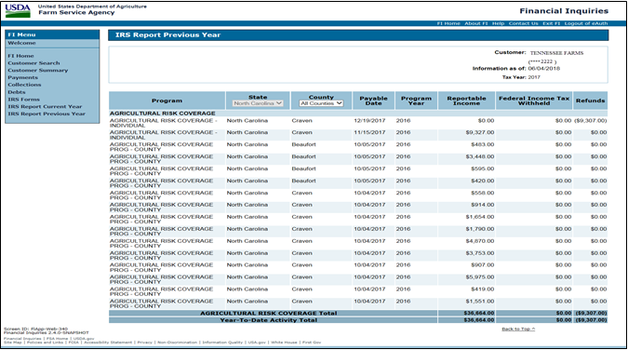

IRS Report Previous Year Screen
The IRS Report Previous Year Screen will display IRS reporting for the previous year. Click “IRS Reporting Previous Year” from the FI Menu.
If user has access to multiple States and/or counties, field headers will have drop-down menus to select criteria.

Slide 47
IRS Report Previous Year Screen (Continued)
The following table describes the IRS Report Previous Year Screen fields.
Field | Description
Customer | Individual who earned the program payment
Last 4 digits of TIN | TIN of individual who earned program payment
Information as of (mm/dd/yyyy) | Date information was last updated in FI
Tax Year | Previous tax year
Program | Program in which payment was made
State | State in which payment was made
County | Service Center responsible for issuing payment
Payable Date | Date payment was issued
Program Year | Crop year, program year, calendar year or budget year, if applicable
Reportable Income | Amount reportable to the IRS
Federal Income Tax Withheld | Amount withheld from payment and submitted to the IRS on the recipient’s behalf
Refunds | Amount of refunds Note: Refunds are not reported to IRS
Totals | Program Totals Year-To Date Activity Totals.

Slide 48
Helpful USDA Customer Links
Create an Account – Getting Started:
https://identitymanager.eems.usda.gov/registration/index.aspx
Forgot my Password:
https://www.eauth.usda.gov/accountservices/ForgottenPassword/Step1_Forgotten Password.aspx
Forgot my User ID:
https://www.eauth.usda.gov/accountservices/ForgottenUserID/Step1_EnterUserInfo.aspx
Change my Password:
https://www.eauth.usda.gov/accountservices/ChangePassword/Step1_ChangePassword.aspx

